Slide 1
Half-Nelson
Mike
Sam
Will
Draw
nutmeg
Buttonhook
Zone read
Wheel Route
Set
Alley-oop
Blitz
Greco Roman
K.O.
Brick
Dink
birdie
Around the horn
Slant
Hat Trick
Ace
Flex
Bunker
Love
Slam
Eagle
Phosbury Flop
Dropping dimes
Single leg
Pickle
Down and distance
Flick
Tech Fall
Hail Mary
Libero
Bicycle Kick
Screen
Give & Go
Sacrifice fly
Spike
K
Flopper
Hook & Ladder
Drop Step
Cover 2
Air ball
The Wheel
Trap

Slide 2
Getting that GREAT shot!!
Part 1 – Building Relationships
Part 2 – Types of photos every photographer should shoot & be aware of
Part 3 – Location, Location, Location
Part 4 – equipment

Slide 3
Building relationships
Coaches – getting to know the coach is a powerful piece to getting great sports photos.
Players – making sure players know who you are and what you are doing.
Game officials – they are your best friend or your worst enemy and can have you removed, don’t make a scene with one of them. Get to know them, talk to them about where they might be located, moving etc. They want to help but remember they have a job to do as well.

Slide 4
Coaches
Learning the playbook
Access to the locker room (and other places most people can’t go).
Remember this comes at a price – and you have to pay that price or lose that source.
Learn their language, not just fake knowledge, really know it.

Slide 5
Players
Access to playbook
Inside information – locker room talk
Familiarity leads to relationships and potential scripted photos/special shots
Good people to get to know - popularity

Slide 6
UIL rules you need to know
http://www.uiltexas.org/media/info/photographer-guidelines
Discussions on these topics:
http://www.texasphotoforum.com/forum/sports/111266-uil-photography-policy.html
http://www.sportsshooter.com/
How do these rules apply to you:
Your home gym
On the road
Playoffs
State Championships

Slide 7
Types of Photos
Action – actual moments captures during game play
Reaction – players, coaches, or fans reacting to the events of the game/match
Rituals – athletes have their ways. Capture them! Teams and individuals have repeated actions that help them get “Psyched” for the game.
Coach – Nobody is more invested in what is happening on the court than the coach. Keep an eye on him or her.
Fans – They can be terrifically goofy/intense/emotional. Turn around and shoot them.
Features – These are great photos because of their composition, lighting, or off-beat content, not necessarily their importance.
https://docs.google.com/present/embed?pli=1&id=d92hp8q_29gbdpgwhr

Slide 8
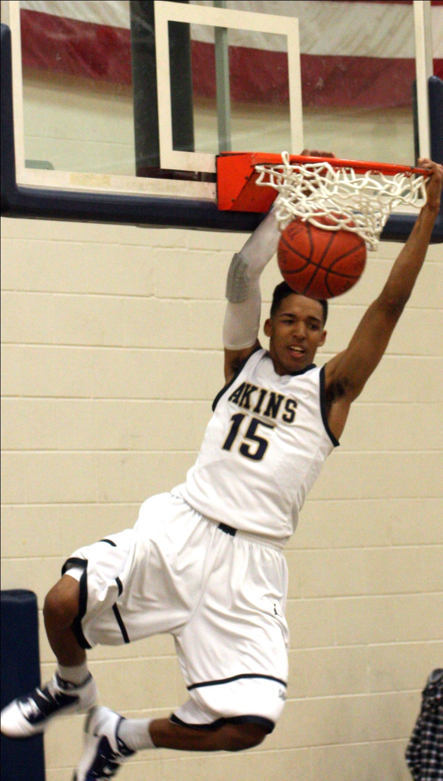
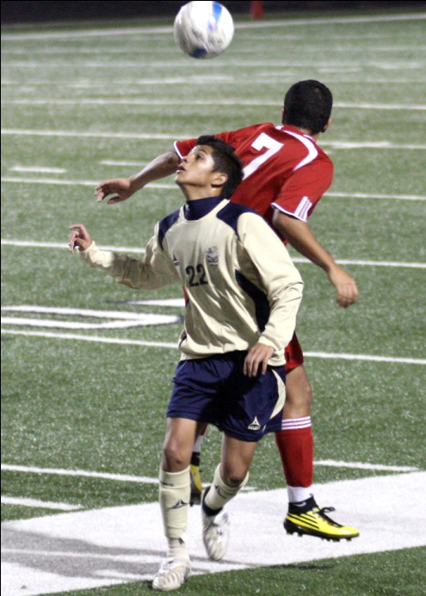
Action examples

Slide 9
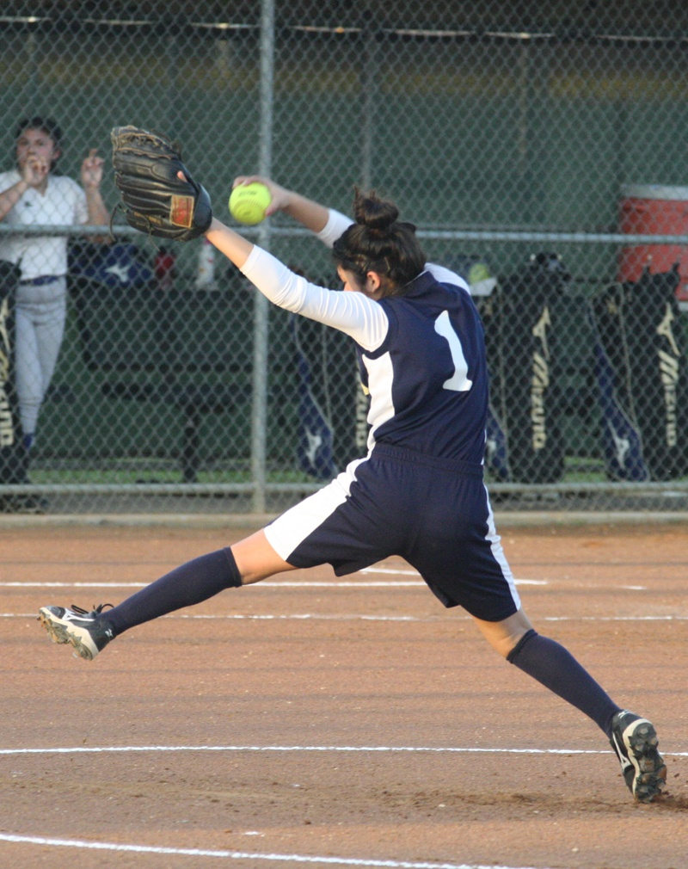
More Action examples

Slide 10
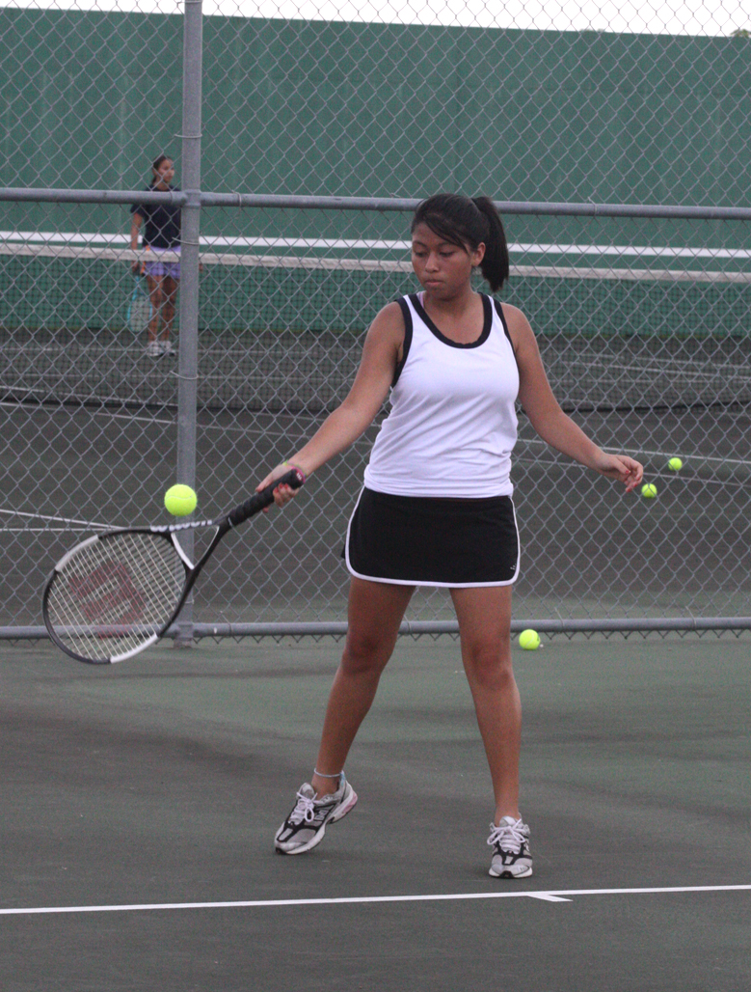
Action continued

Slide 11
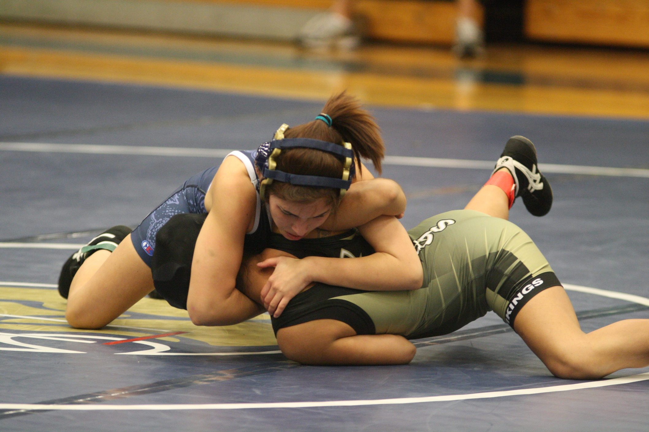
Action continued

Slide 12
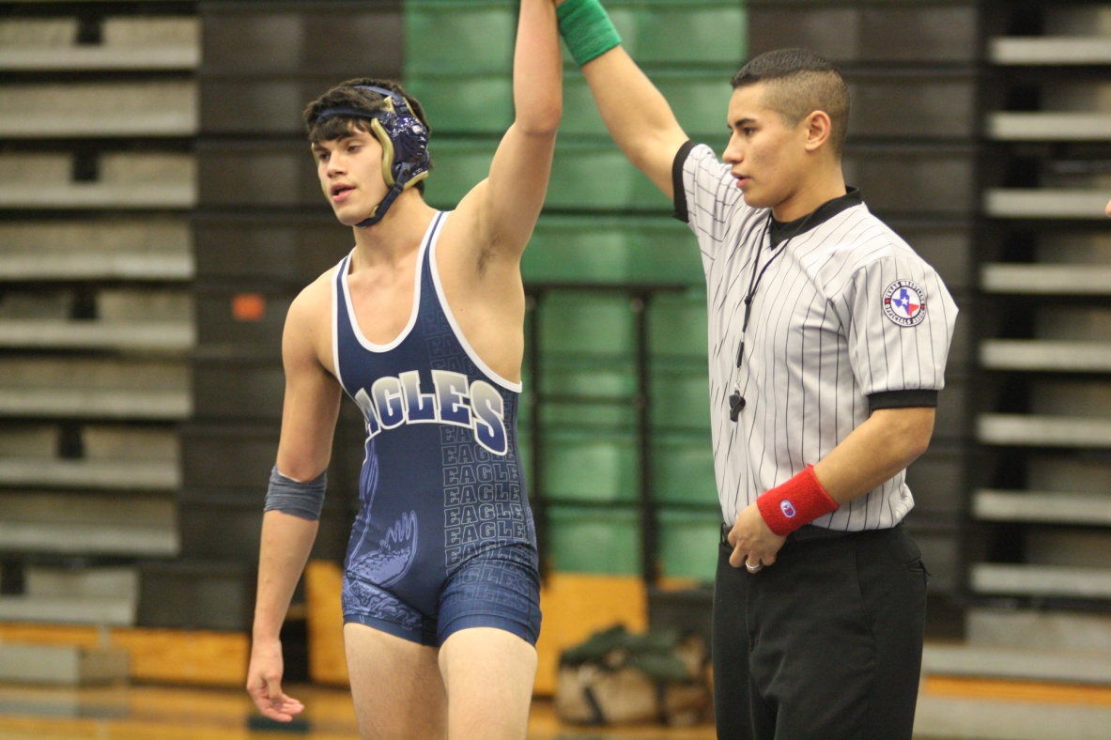
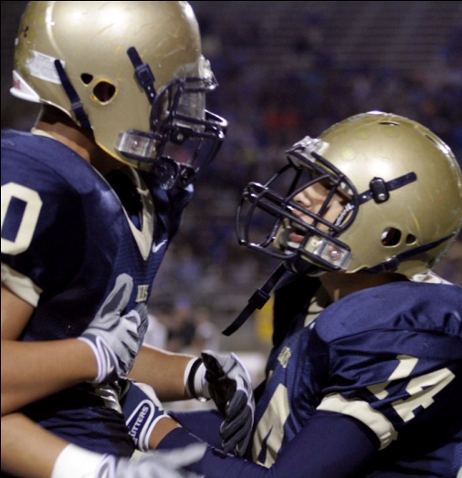
Reaction examples

Slide 13
Reaction continued

Slide 14
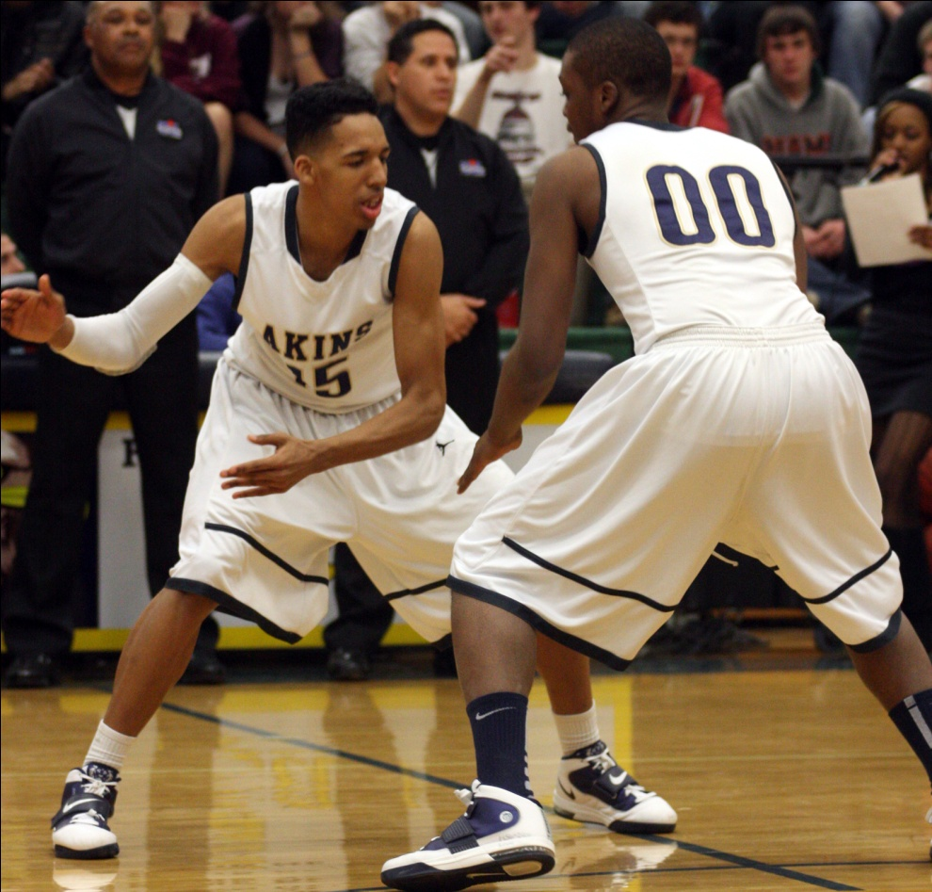
Rituals

Slide 15
Ritual continued

Slide 16
Coach

Slide 17
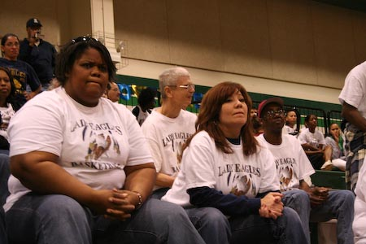
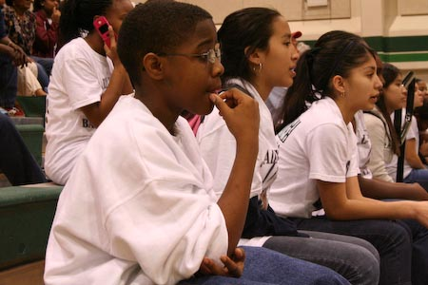
Fans

Slide 18
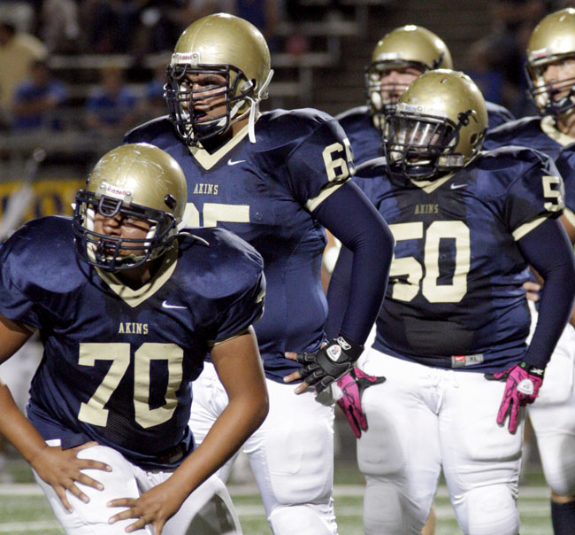
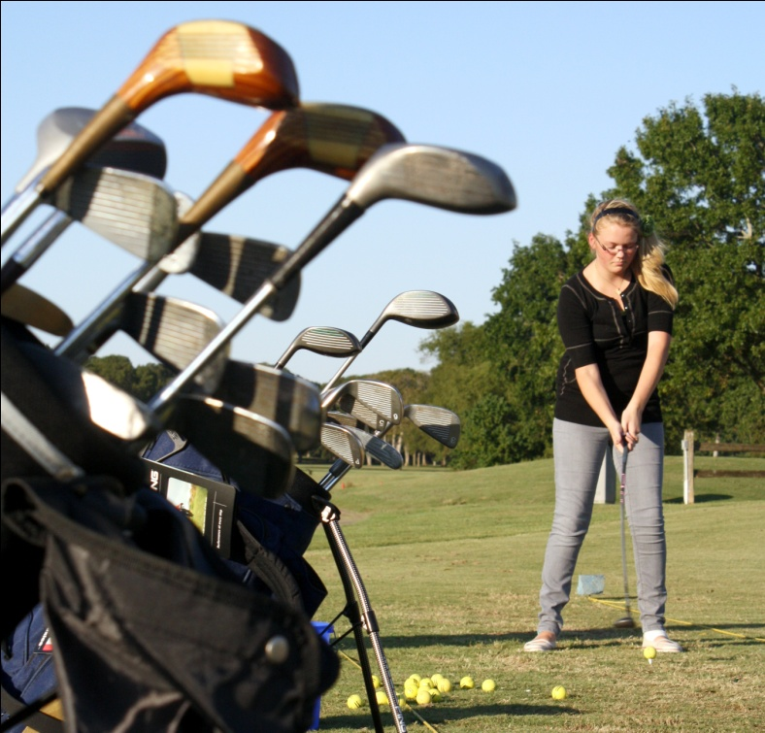
Feature

Slide 19
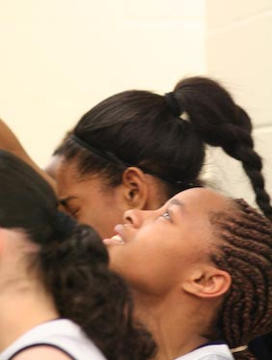
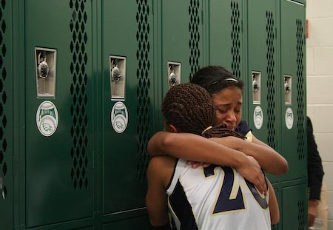
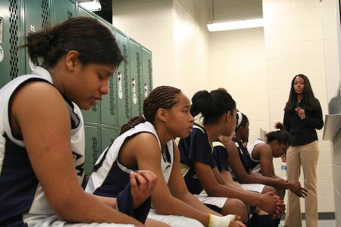
Features continued

Slide 20
Location, Location, Location
Knowing where to shoot is almost as important as knowing how and what to shoot.
Every sports venue has “sweet spots” and “safe” places. Know where they are and how to access them.
Lights, hot spots, florescent bulbs and obstructions exist, do your homework before the shoot.
Practice – shoot the game before (JV and frosh), go to practice and shoot there, shoot other teams at the same facility
Weather

Slide 21
Football
Knowing the playbook helps to anticipate action.
Unusual angles – go where other photographers aren’t.
Know your terms - (down and distance, third and short, etc.).
Know your schools tendencies when faced with certain situations (draws, screens, slants, wheel routes, etc.).
Don’t watch the ball – sometimes you can get great photos by concentrating on one player
Help your school start/build a photo wall in the locker room/gym (this makes your coach happy!!!).
Try to get a photo of every player on the team in action.

Slide 22
Basketball
Use a flash if you can – especially in dark gyms.
Get above the rim for “flying” shots.
Don’t forget defensive plays.
Change positions a lot – move around – sit on the bench if you can.
Talk to site admins/refs before hand – this is the place where you can run into problems.
You need to know basketball to get great shots here. Anticipate.
Basketball has plays (Wheel and Flex offenses are common) – learn them too.
Final thought - armpits are gross…

Slide 23
Baseball / softball
Tough sports to shoot – plan to stay a while
Get permission to be in the dugouts (pre-season especially)
How do you shoot an outfielder?
Arrive early – stage photos and shooting warm-ups are perfect times – get permission to be on the field during those times
Shoot your teams inter-squad games – ask coaches to put players in uniform for those games.
Down the lines, step stools, and

Slide 24
Wrestling
Mat access is crucial – talk to coaches – you should have access to the edge of the mat.
Muscle definition is amazing and you can really get some crazy photos.
Short lenses work well here, but they better be fast.
Dual meets will probably get you more access than the tournaments or the state meet.
Preseason is great as most coaches are fine with more access in preseason.

Slide 25
Soccer
Some of these are played during the day on the weekend, get to those games, those will be your best places to get awesome photos.
Goalies are hard to shoot, get some staged photos so you have some safety shots.
Behind the goal is a great place to get action coming at you.
Anticipate head balls, corner kicks and set pieces.

Slide 26
Volleyball
A difficult sport to shoot, kiss your fast lens and your digital camera back in the day this was a nearly impossible sport to shoot.
Get permission to stand on the referee stand during warm-ups (preseason especially).
Shoot down the net line from the stands.
Always get there early and shoot warm-ups, remember the defensive shots too.
There are plays in volleyball too, and you can find out what they are.

Slide 27
Misc.
Tennis – corners, at the net, service lines.
Golf – safety shots and staged photos, bunker shots, putting is boring….. Remote fire possibilities.
Track – lots of options – be careful with field events.
Cross-country – Start, during, finish line – post run.
Weightlifting – Viewpoint
Water polo/swimming – glare reducing filters, underwater cameras, viewpoint
Others - ???

Slide 28
Mistakes my kids make
Shooting horizontal – Sports are upright – you should be shooting vertically at least 80% of the time. Horizontal shooters are lazy “photoshoppers.” The BEST photos fill the frame fully and are NOT cropped in Photoshop.
Headphones/iPods – this makes me crazy – you need to hear the sport to anticipate.
Not watching play/safety – goes hand in hand with wearing headphones. Turning your back to the action on the field especially football.
Gathering in groups and “hanging out” – seeing four photographers standing near each other means no one is getting great shots.
The “overachiever” – fills the card without thought or care or gets a camera every week and comes back with nothing or poor quality photos without effort.

Slide 29
Equipment
Camera bodies – Cannon versus Nikon versus all the rest
Lenses – short, fix-F-stop, 200-2.8, 125-2.8, extreme wide angles (not quite a fisheye)
Flashes – expensive “speed” flashes work very well to stop action at low shutter speeds – can create some blur, ethics?
Misc. – tripods, monopods, fish eye lenses, tilts, teleconverters (get more focal length at a price), macros, remote flashes
http://reevesworks.blogspot.com/

