Slide 1
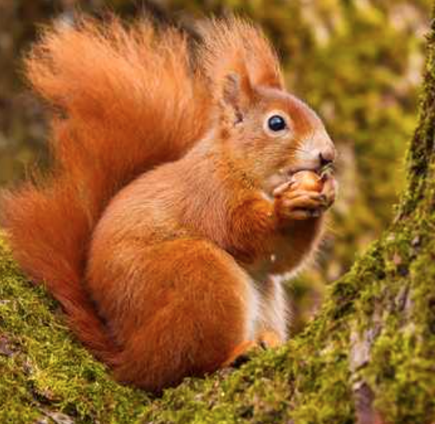
Hunting for Nut Graphs: Writing with Purpose
Kathleen McElroy, University of Texas at Austin
School of Journalism and Media
December 2020

Slide 2
A nut graph
A news industry term for a paragraph or paragraphs early in a story that explain why the piece is important and why consumers should keep consuming

Slide 3
A nut graph
A news industry term for a paragraph or paragraphs early in a story that explain why the piece is important and why consumers should keep consuming
The ‘nut’ is the key kernel of the story that explains why we should care about it

Slide 4
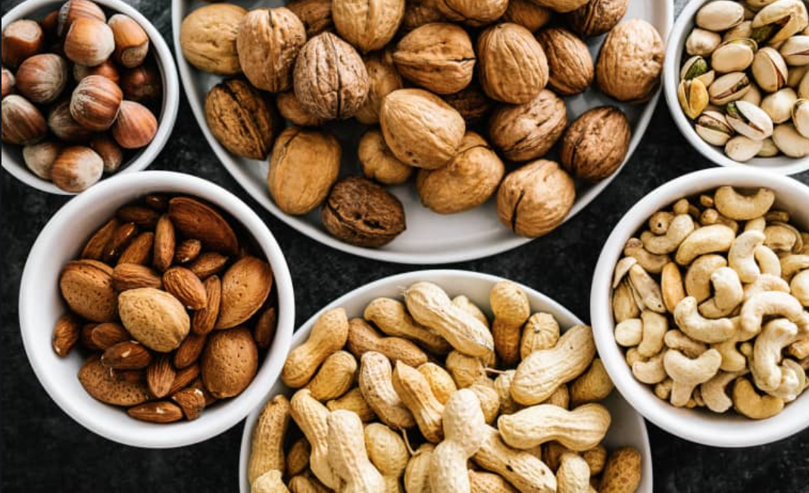
A nut graph
A news industry term for a paragraph or paragraphs early in a story that explain why the piece is important and why consumers should keep consuming
The ‘nut’ is the key kernel of the story that explains why we should care about it
'Graph’ is short for ‘paragraph’

Slide 5
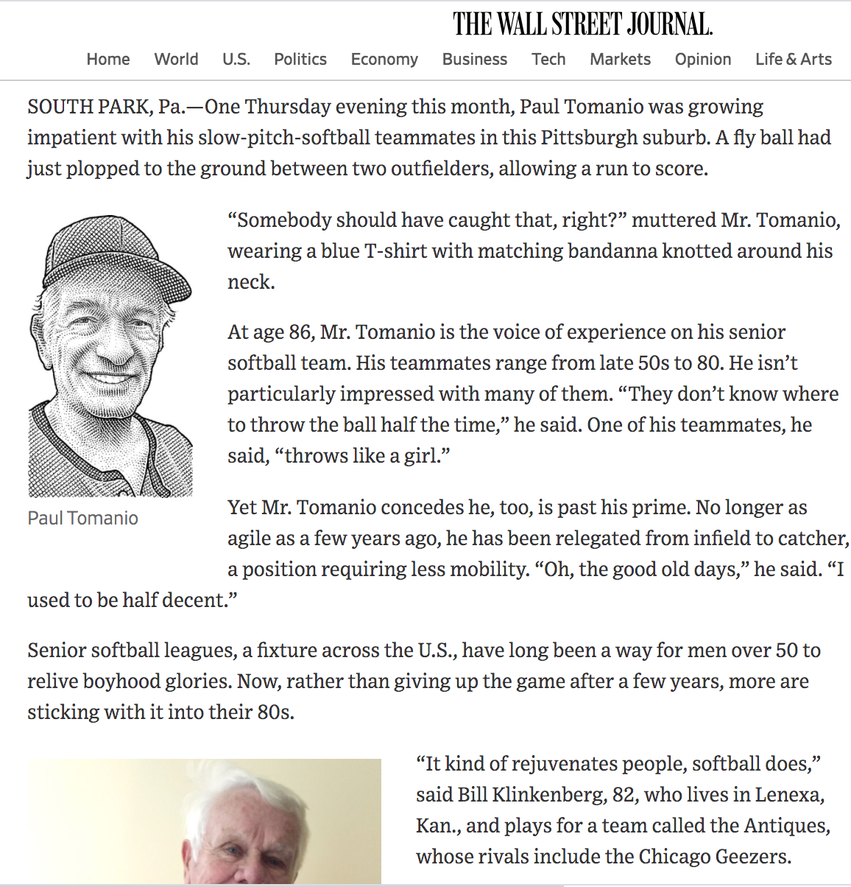
https://www.wsj.com/articles/whos-on-first-great-grandpa-softball-bends-the-rules-for-seniors-1502984629
Notes:
WSJ model for feature writing:
Anecdotal lead, Nut graph, Body of the story is supporting information (quotes, statistics, developments, Ending includes anecdote relating to lead

Slide 6
https://www.wsj.com/articles/whos-on-first-great-grandpa-softball-bends-the-rules-for-seniors-1502984629

Slide 7
https://www.poynter.org/archive/2003/the-nut-graf-part-i/

Slide 8
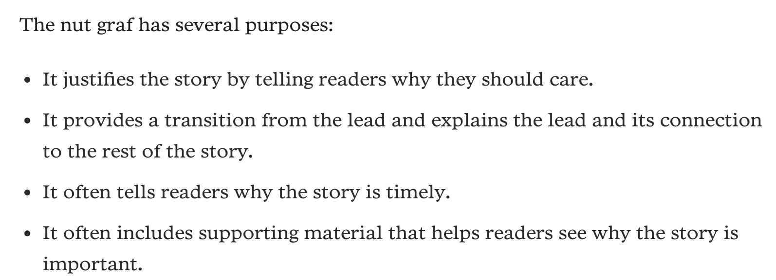
https://www.poynter.org/archive/2003/the-nut-graf-part-i/

Slide 9
https://www.poynter.org/archive/2003/the-nut-graf-part-i/
Make up your mind what the story is about and why people should read it — then write your synopsis in one or two sentences.
That’s your nut graph!

Slide 10
Nut graphs work in all stories
With traditional hard-news lede:
Provides further context for the news and puts the newest news in perspective.

Slide 11
Nut graphs in all stories
With traditional hard-news lede:
With a feature or a delayed lede:
Provides further context for the news and puts the newest news in perspective.
Supplies the newsworthiness of the story

Slide 12
Nut graph
with
a news
lede
Nut graph with a
delayed lede

Slide 13
By TYRA DAMM
When the world started to shut down in March this year, I was thinking in terms of a couple of weeks.
For example, “We’ll be back in school in two weeks,” and “I’ll buy just a couple of masks to get us through the next couple of weeks,” and “We have enough toilet paper to get us through a couple of weeks.”
My spring break 2020 optimism and/or naivete didn’t prepare me for the pandemic-riddled reality of Christmas 2020.
Now that December is here, I continue to wonder if I’m making the best of the circumstances, if I’m too cautious or too careless. And, as I often do with uncharted conditions, I wonder how my late grandmother would have handled the whole thing.
Gramma Kathryn was a treasure. Creative, funny, stubborn. Artist, gardener, wordsmith. She died in 2005, but her legacy lives on in published poetry, handwritten recipes and tales from anyone who knew her and loved her.

Slide 14
Why this story? Why now?
“Before you start writing your story, you should have reread your reporting notes numerous times to ensure you have a grasp on the story. Decide what the news is and why it matters. Essentially, figure out your nut graph, then determine which kind of lead the story needs.”
Journalism Professor Tracy Dahlby

Slide 15
Is the nut graph near the top of the story?
Does it encapsulate the meaning of the story?
Does it tell readers why this story is important and timely? Or is this story a window into a world that we should know?
Does it explain where the story comes from, where it might be going and what’s at stake?
Does it “billboard” the story’s key elements, be they political, social, economic, cultural, simply human or all of the above?
Journalism Professor Tracy Dahlby

Slide 16
Gathering relevant, accurate, dimensional information
Incorporating relevant voices
Crafting a sound nut graph that explains story’s significance
Structuring the story to support the nut graph
Writing/producing clear content
Grammar/Spelling/Punctuation
Crafting an inviting, relevant lede

Slide 17
Examples of introductory reporting students incorporating nut graphs into their feature stories

Slide 18
Nut graph
In almost all intramural coed soccer programs across the nation, a goal scored by a female player counts for 2 points instead of the standard 1 point when scored by a male. As a result, both male and female players have mixed feelings on the rule. Some call it sexism or see it as unfair, especially as women’s soccer has grown as a global sport. But many have also come to accept the rule and use it as an advantage to score more points.
trisportsnc.com

Slide 19
Nut graph
Lead and nut graph
In almost all intramural coed soccer programs across the nation, a goal scored by a female player counts for 2 points instead of the standard 1 point when scored by a male. As a result, both male and female players have mixed feelings on the rule. Some call it sexism or see it as unfair, especially as women’s soccer has grown as a global sport. But many have also come to accept the rule and use it as an advantage to score more points.
He had a clear shot. He could have easily kicked the ball and scored a goal, which isn’t easy in soccer. But knowing that it would only count for 1 point, a split-second hesitation turned into a surrender as he passed the ball to the nearest female teammate on the field.
This scene is nothing new. In almost all intramural coed soccer programs across the nation, a goal scored by a female player counts for 2 points instead of the standard 1 point when scored by a male. As a result, both male and female players have mixed feelings on the rule. Some call it sexism or see it as unfair, especially as women’s soccer has grown as a global sport. But many have also come to accept the rule and use it as an advantage to score more points.

Slide 20
Nut graphs
[Thomas] Bolt said he was fortunate to have places to stay with his fraternity brothers during the holiday season. Many other international students stayed in dorms or West Campus apartments during the holidays and sometimes relied on their friends and church communities.
Of the 39,619 undergraduate students enrolled at the University of Texas at Austin in 2015, almost 10 percent are international. As of Fall 2016, the International Student and Scholars Services listed 5,399 total international students on campus.
Not every international student can afford to travel home for holidays or school breaks. Bolt said his family couldn’t justify the travel expense for only a month at home but is thankful that he avoided staying at UT Austin during winter break.
Texas Tribune

Slide 21
Nut graph
Lead
[Thomas] Bolt said he was fortunate to have places to stay with his fraternity brothers during the holiday season. Many other international students stayed in dorms or West Campus apartments during the holidays and sometimes relied on their friends and church communities.
Of the 39,619 undergraduate students enrolled at the University of Texas at Austin in 2015, almost 10 percent are international. As of Fall 2016, the International Student and Scholars Services listed 5,399 total international students on campus.
Not every international student can afford to travel home for holidays or school breaks. Bolt said his family couldn’t justify the travel expense for only a month at home but is thankful that he avoided staying at UT Austin during winter break.
The Christmas tree was decorated, standing proudly in the corner. It emitted a fresh, piney scent that faintly veiled the smell of leftover ham wafting from the kitchen. Smiling family pictures looked down at Thomas Bolt as he lay on the couch trying to sleep on Christmas Eve. He looked around the festive room once more before closing his eyes.
It was beautiful, warm and inviting, but it wasn’t his home.
Bolt is a junior finance major from Wollongong, New South Wales, Australia, who studied at UT Austin as sophomore during the 2015-2016 school year. His study abroad program meant that he would spend Christmas in Texas.
“I didn’t go home for Christmas,” said Bolt, who’s back in Australia finishing his degree. “Instead I relied on friends I made from my fraternity and went from house to house in Dallas. It was a fun experience, but I honestly think it would’ve been nicer to be home with my family.”

Slide 22
Nut graph
The Carver is located in a historic building in East Austin, whose changing demographics and rising rents have pushed out African Americans once relegated to the neighborhood. Museum administrator Para Agboga said using the term “community” is a little different now because of gentrification. But she added one thing she believes isn’t going away anytime soon is the Carver.
Carver Museum

Slide 23
Nut graph
Lead
The Carver is located in a historic building in East Austin, whose changing demographics and rising rents have pushed out African Americans once relegated to the neighborhood. Museum administrator Para Agboga said using the term “community” is a little different now because of gentrification. But she added one thing she believes isn’t going away anytime soon is the Carver.
Just as a tour guide would, Rosetta Pitts interprets and then recites stories to three small girls in tow at The George Washington Carver Museum. She points at photos and then moves on to the next exhibit. Stopping at the big map on the wall, her face falls. She points to Killeen and then crouches down, now at eye level with her granddaughters.
“Don't forget our history,” she said to the girls. “We can't forget where we came from.”

Slide 24
This is a common exercise for teaching students how to write a nut graph.
Prompt: Write a nut graph for the Thursday edition of the Pacific Coast University publication.
When Janet Nguyen left the Smith-Yang Library Tuesday afternoon, she was stunned by what she didn't see.
“My bike was gone,” she said. “That’s the third bike I’ve had stolen this year. And I had a huge lock on it, too.”
LaShawn Johnson had a $300 mountain bike stolen from outside Gonzales Hall last week.
“I know of at least three other people whose bikes have been stolen this semester,” he said. “That’s it. From now on, I’m walking.”
Even Elena Guerra, president of the University Biking Club, had her bike stolen during a club meeting last month.
“I’ve never seen anything like this,” said Raymond Jones, chief of security on campus. “Whether it’s one thief or a whole gang, we can’t be sure. But it’s an epidemic.”
In an average semester, 50 bikes are reported stolen on campus. So far, this semester, 150 bikes have been stolen, already a record.

Slide 25
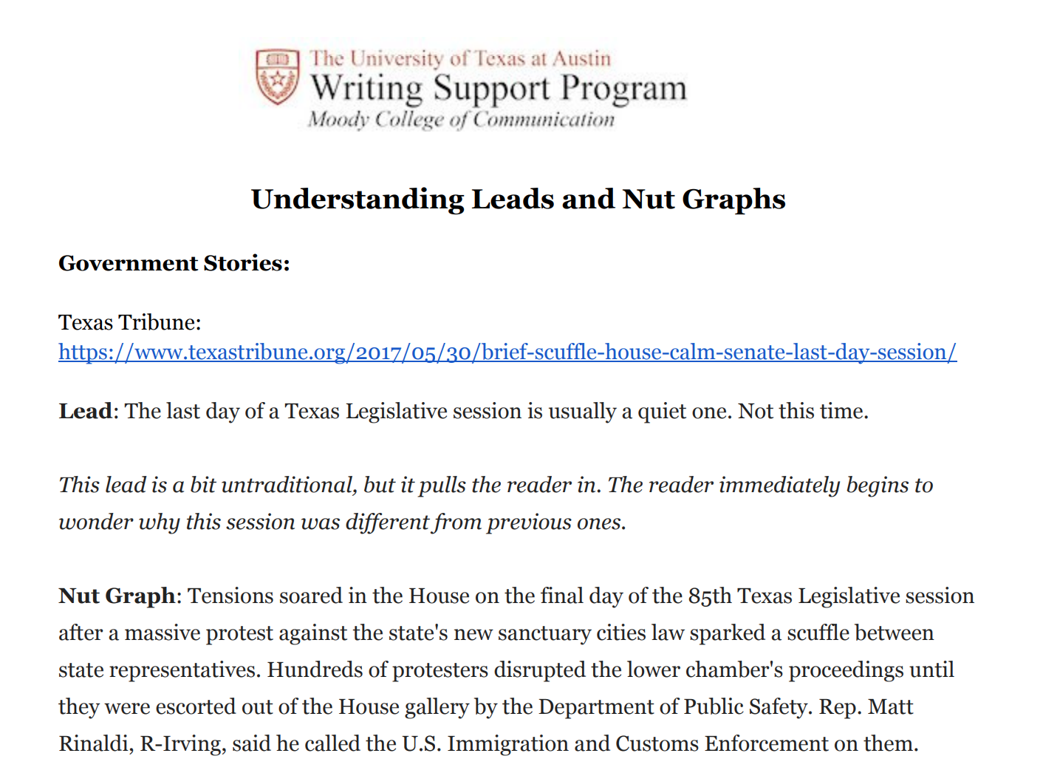
http://sites.utexas.edu/moodywriting/files/
2017/09/LeadsAndNutGraphs.pdf

Slide 26
Questions? Comments?

Slide 27
Thank you!
kathleen.mcelroy@austin.utexas.edu

Slide 28
Cited Professional Pieces
https://www.wsj.com/articles/whos-on-first-great-grandpa-softball-bends-the-rules-for-seniors-1502984629
https://www.nytimes.com/2020/12/07/us/politics/lloyd-austin-biden-defense-secretary.html
https://www.nytimes.com/2020/12/07/arts/music/bob-dylan-universal-music.html
https://www.dallasnews.com/opinion/commentary/2020/12/07/how-would-gramma-have-handled-our-pandemic-reality/

