Slide 1
An ACT of Congress
Noah Recker - La Vernia High School

Slide 2
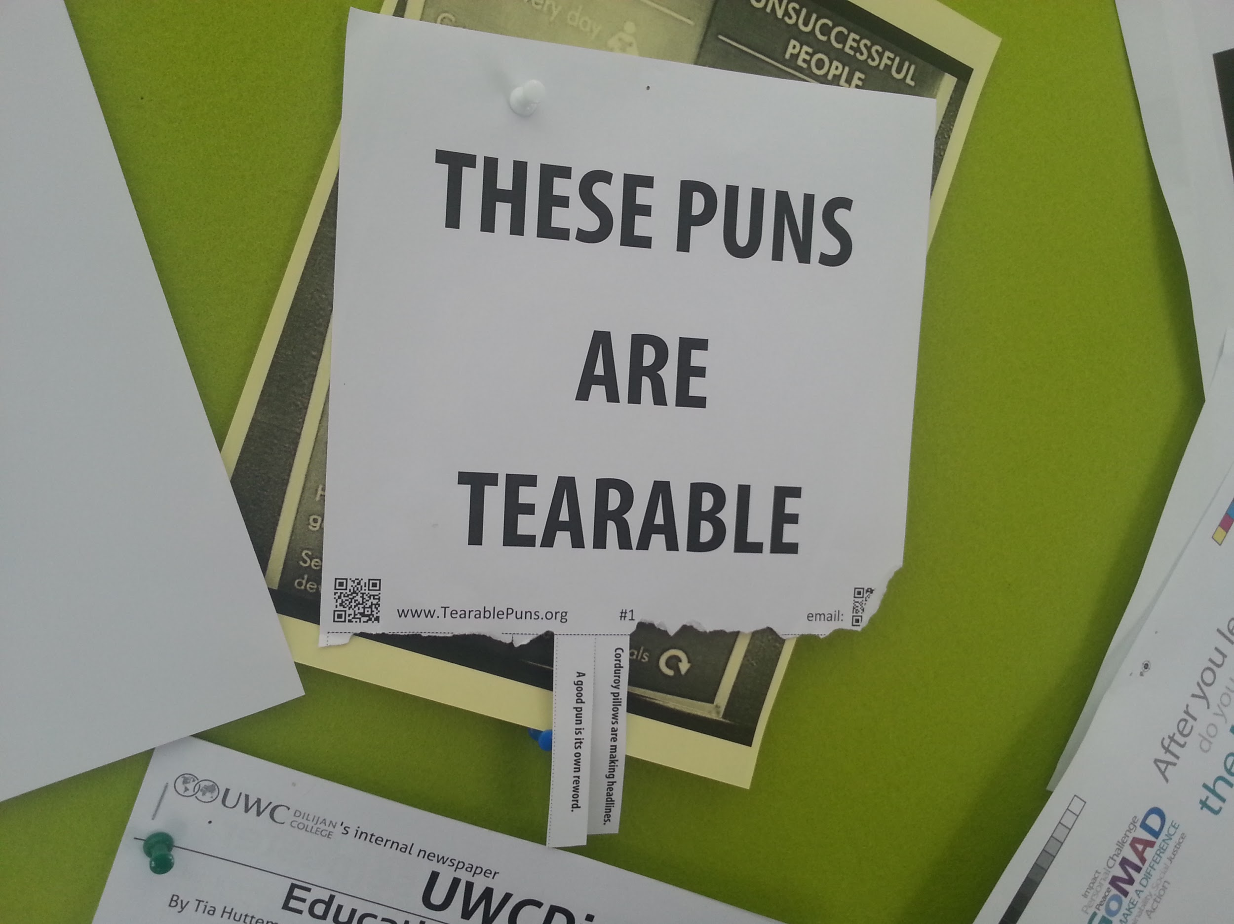
What does a speech look like?
-Intro (Quote, Bad Pun)
-Claim
-Warrant (source)
-Impact
-Repeat

Slide 3
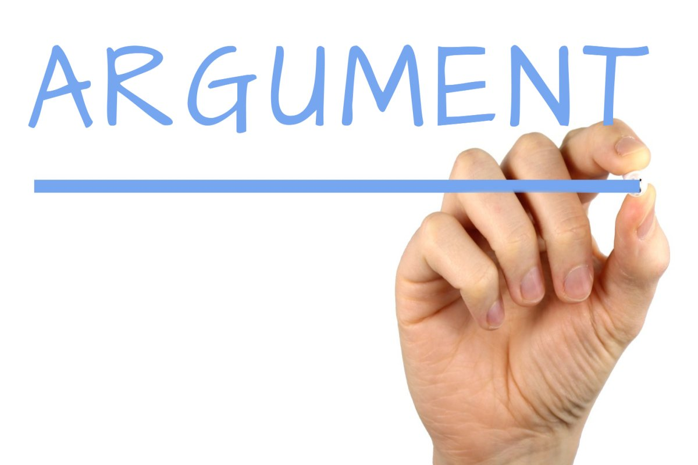
Argumentation DO’s
DO’s
ᶲAddress representatives by LAST name
ᶲHave significant impacts
ᶲDevelop points over time
ᶲFlow previous Speeches

Slide 4
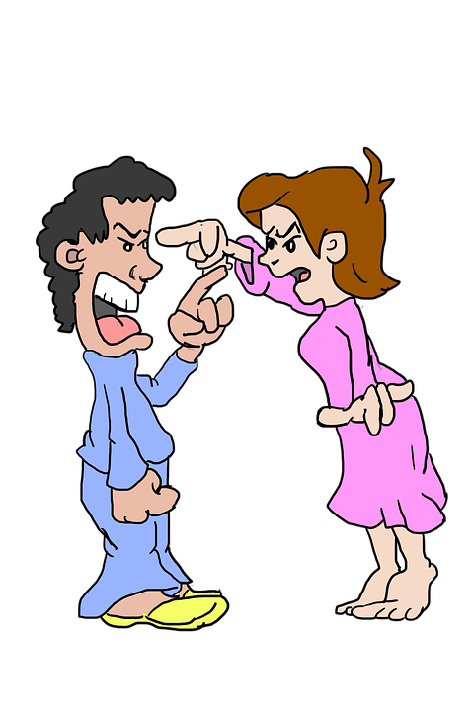
Argumentation DON’T’s
DON’T
X Don’t personally attack
X Don’t be RUDE
X Don’t repeat points just because you have precedence
X Don’t make up information

Slide 5
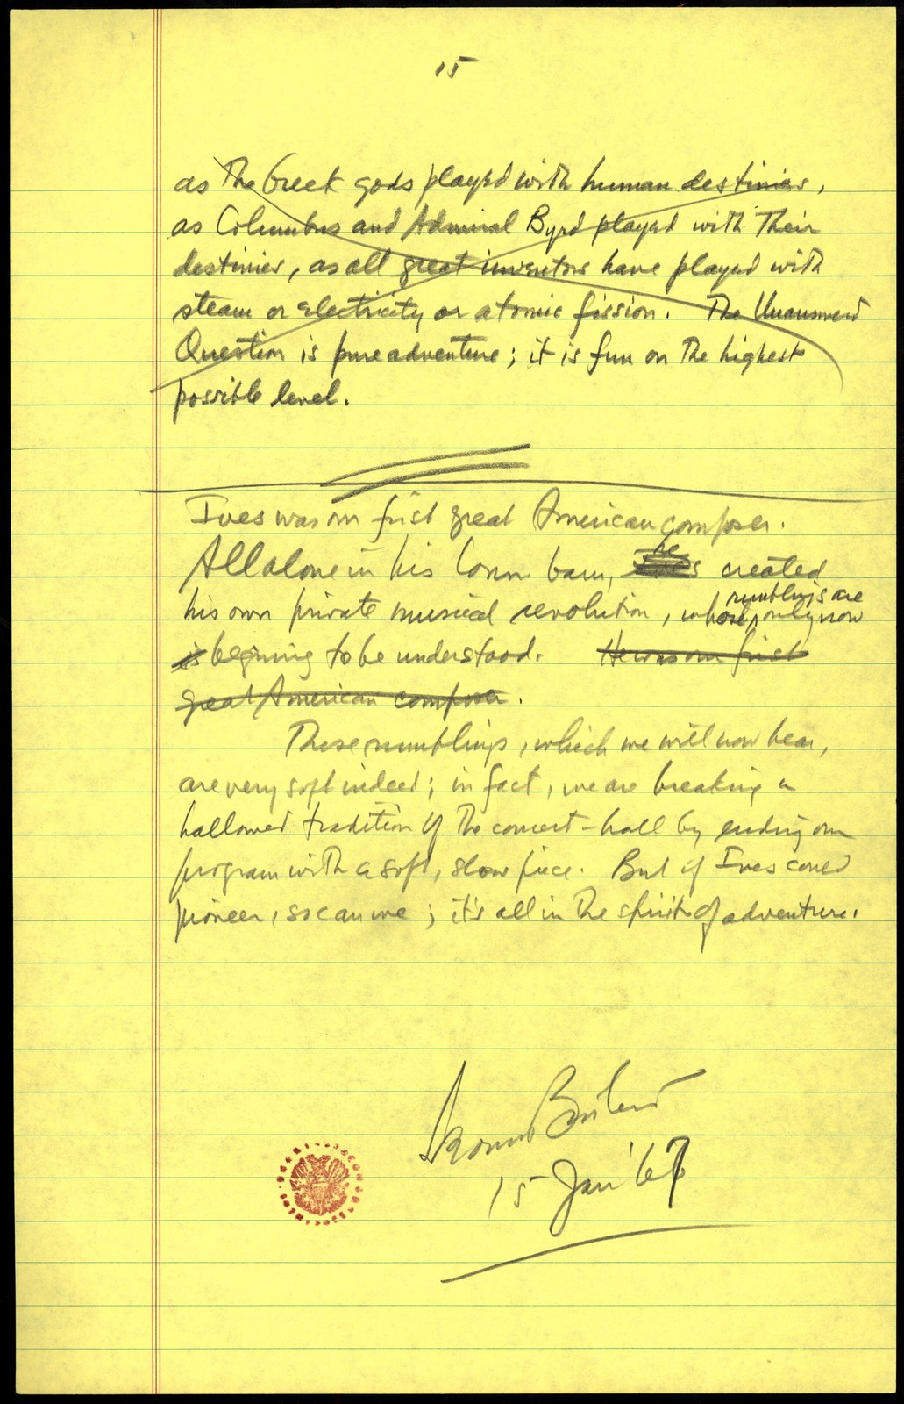
Flowing In Congress
Representative :
AFF_____ NEG_____
Pt.1_________ possible answers
Pt.2_________ possible answers
Pt.3_________ possible answers
Possible Questions

Slide 6
Questioning
•No softball questions
–Ex. Would this bill have a positive effect?
–Ex. What does the bill say?
•Use questions as argumentation triggers
•Don’t BADGER

Slide 7
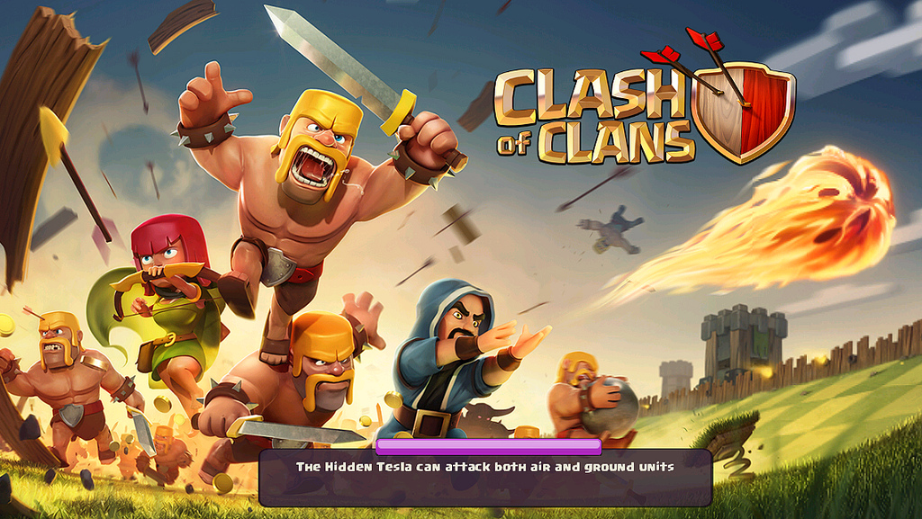
Points of Clash
•Does Congress have the Authority to enact
•Constitutionality
•Funding
•Timeline
•Enforcement
•Foreign Policy

Slide 8
Let’s Practice
https://txfa.org/documents/2018-19/TFA%20Fall%202018%20Legislative%20Docket.pdf
#27 A Bill to Allocate Funding Towards the Research of Disease Resistant Bananas

