Slide 1
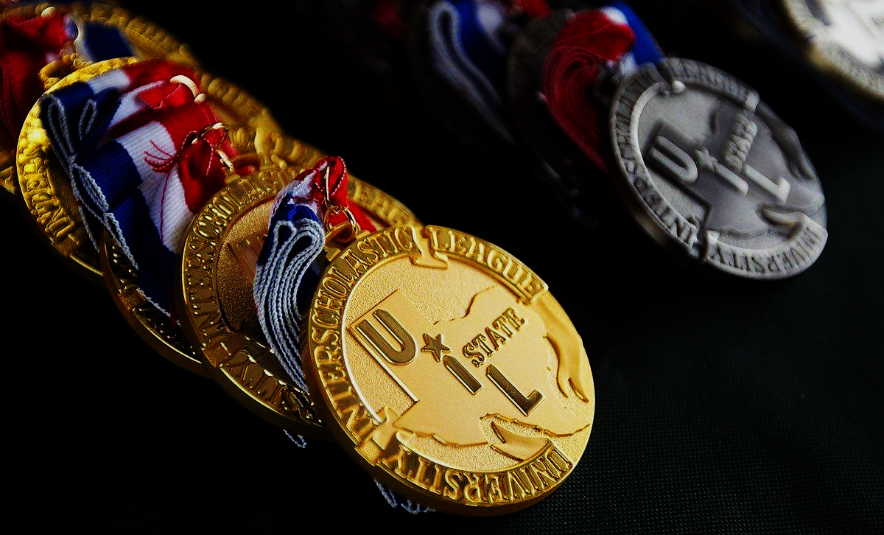
Prose & Poetry:
Starting at the Beginning
(With the end in mind)
Presented by Maribeth Harlow
UT SAC October 26, 2019

Slide 2
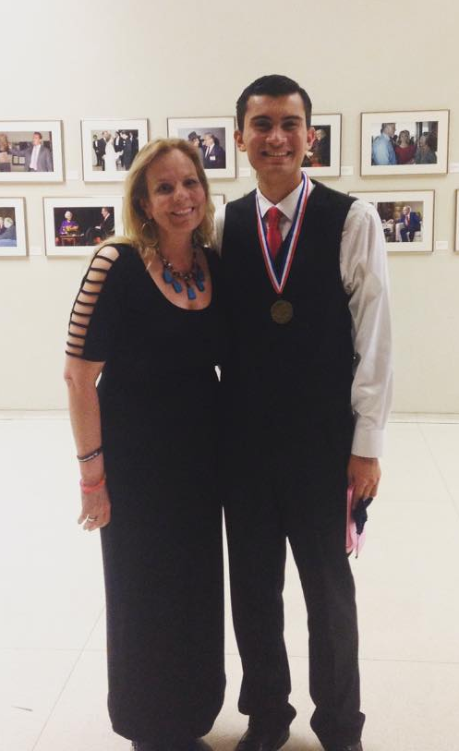
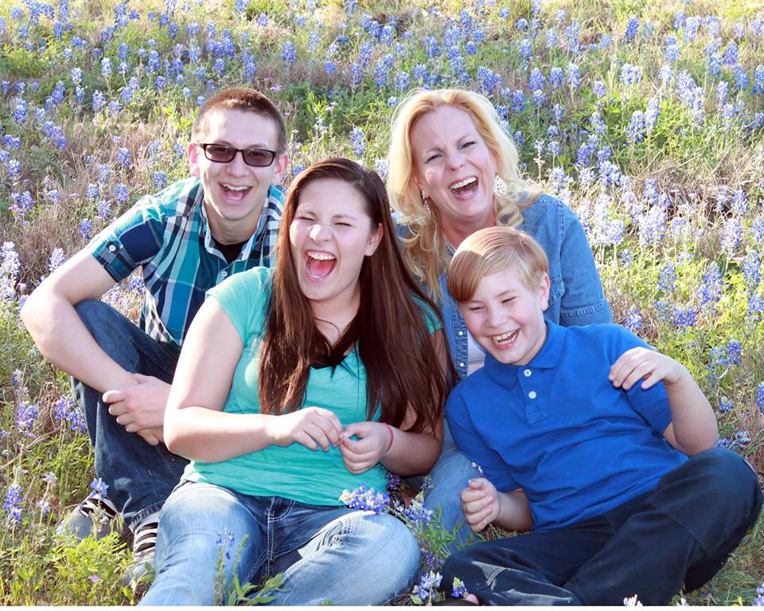
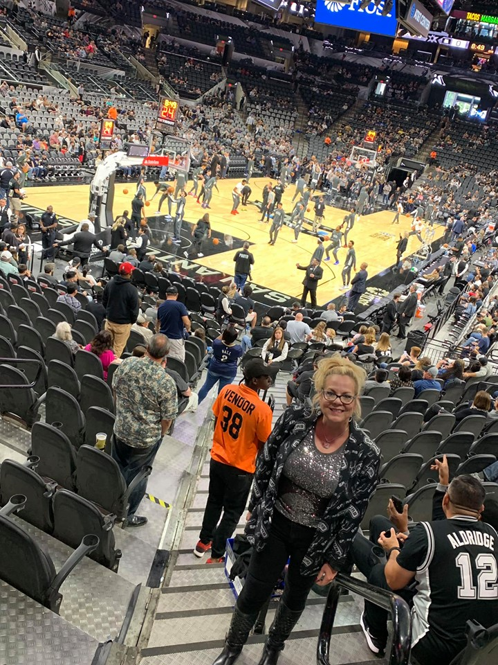
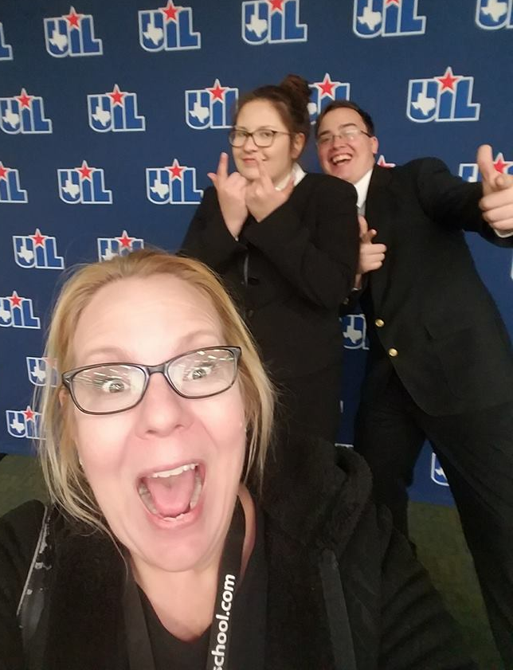
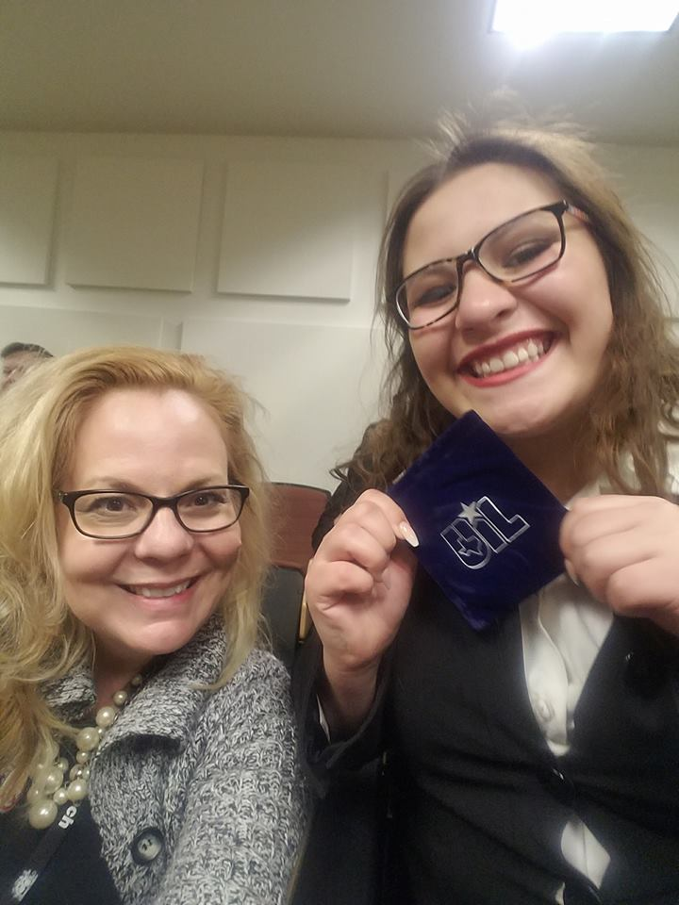
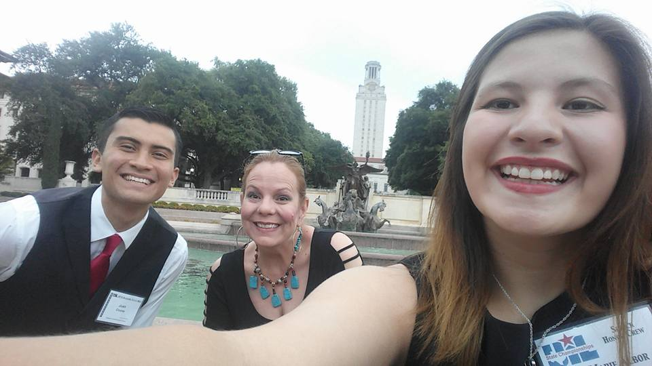
This is ME…
I am a product of UIL in both speech and One Act Play. I have taught for 22 years and coached or directed most of that time as well.
I am the proud mother of three dragons, who I have also coached and directed. I am a Spurs fan, a dog lover, (that is Balto), a daughter to two retired teachers. I have been a UIL Academic Coordinator, OAP director for middle and high school, and now I am an adjudicator and contest manager. I also teach Speech and Debate at Three Rivers High School. This is me!

Slide 3
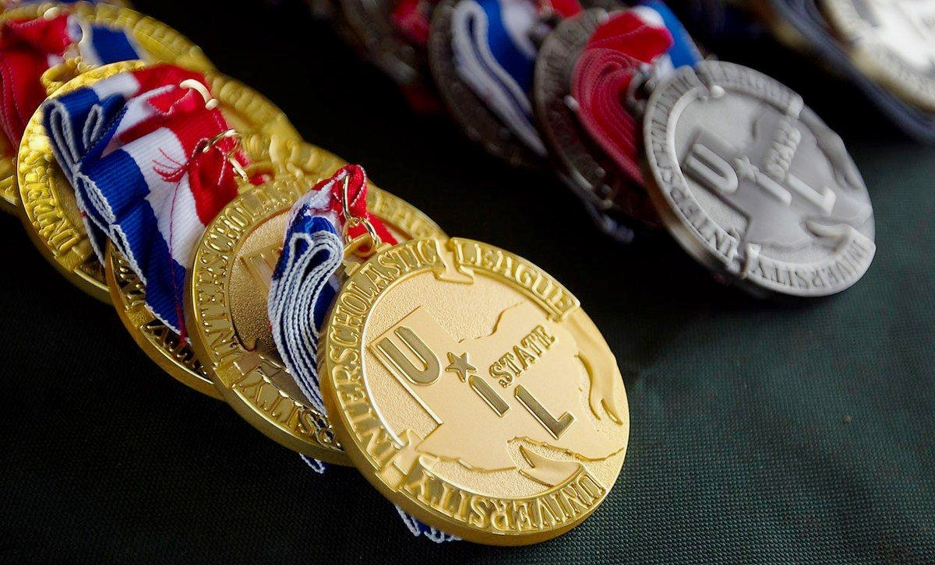
Define Oral Interpretation
Objectives:
Differences between Poetry & Prose
Identifying Categories & knowing the rules!
Finding pieces...
Documentation - what is it?
Contest day...

Slide 4
What is Oral Interpretation?
Oral Interpretation is the art of communicating works of literature by reading aloud!
If you love literature and performance, you are in the right place!
What types of literature are read for Poetry or Prose? In the beginning of the UIL contest, it was easy to define the differences in Poetry and Prose. Poetry was in verse, Prose was in paragraph (ex: novel, short story, fiction, non-fiction, etc.), and Drama was easily identified in a play format (with stage directions and characters identified).

Slide 5
What is the purpose of Oral Interpretation contest?
The purpose of this contest is to encourage the student to understand, experience and share prose (or poetry) works through the art of oral interpretation. (A) Oral interpretation, or the study of literature through its performance, can be defined as a combination of analysis, performance and communication skills offered publicly on behalf of literature. (B) Oral interpretation focuses on literature in performance through expressive oral reading. The goals of this contest are to encourage the contestant’s exploration of a variety of literary selections and to enhance the performer’s and audience’s appreciation of literature through the performer’s interpretation of the work.

Slide 6
Differences between Poetry & Prose

Slide 7
Is it POETRY? Is it PROSE?
The lines have blurred between types of literature.
Now there are “novels-in-verse”, performance pieces, slam poetry, lyrics in publication, and so much more!
When in doubt, start at the UIL website OR
The Library of Congress (and the good old Dewey decimal system) are the definitive sources. Typically Poetry titles are numbered 811 in the Dewey decimal system.
The following example is unique, but UIL has made the ruling.

Slide 8
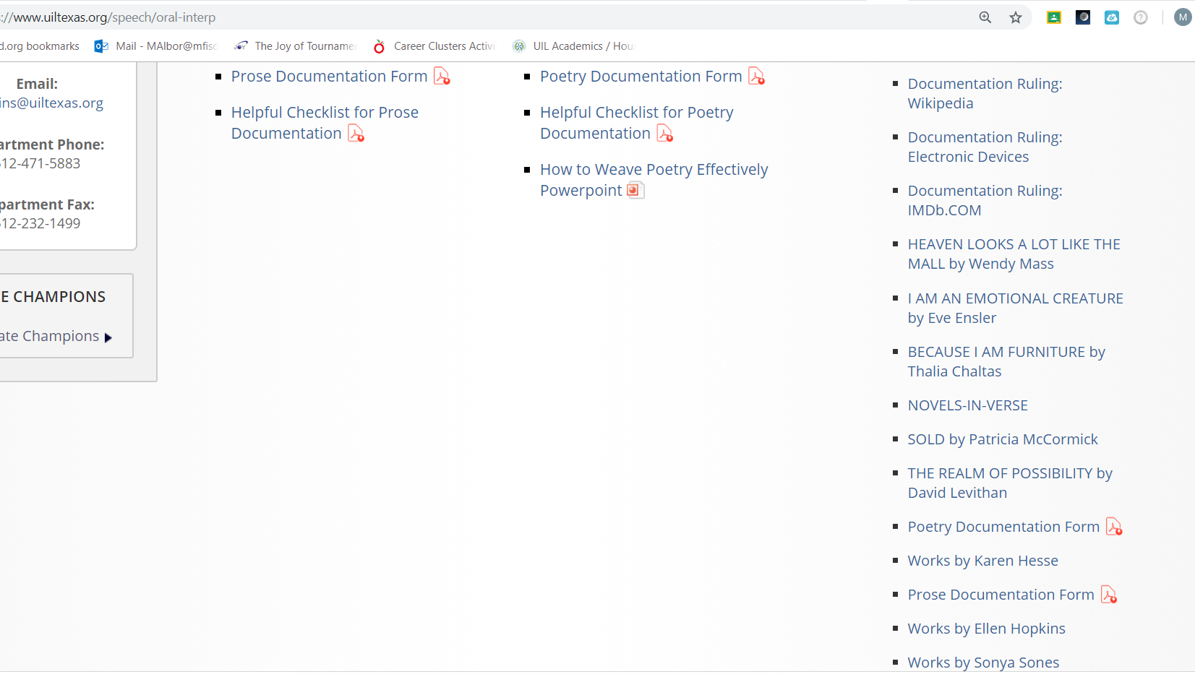
Is it POETRY? Is it PROSE?

Slide 9
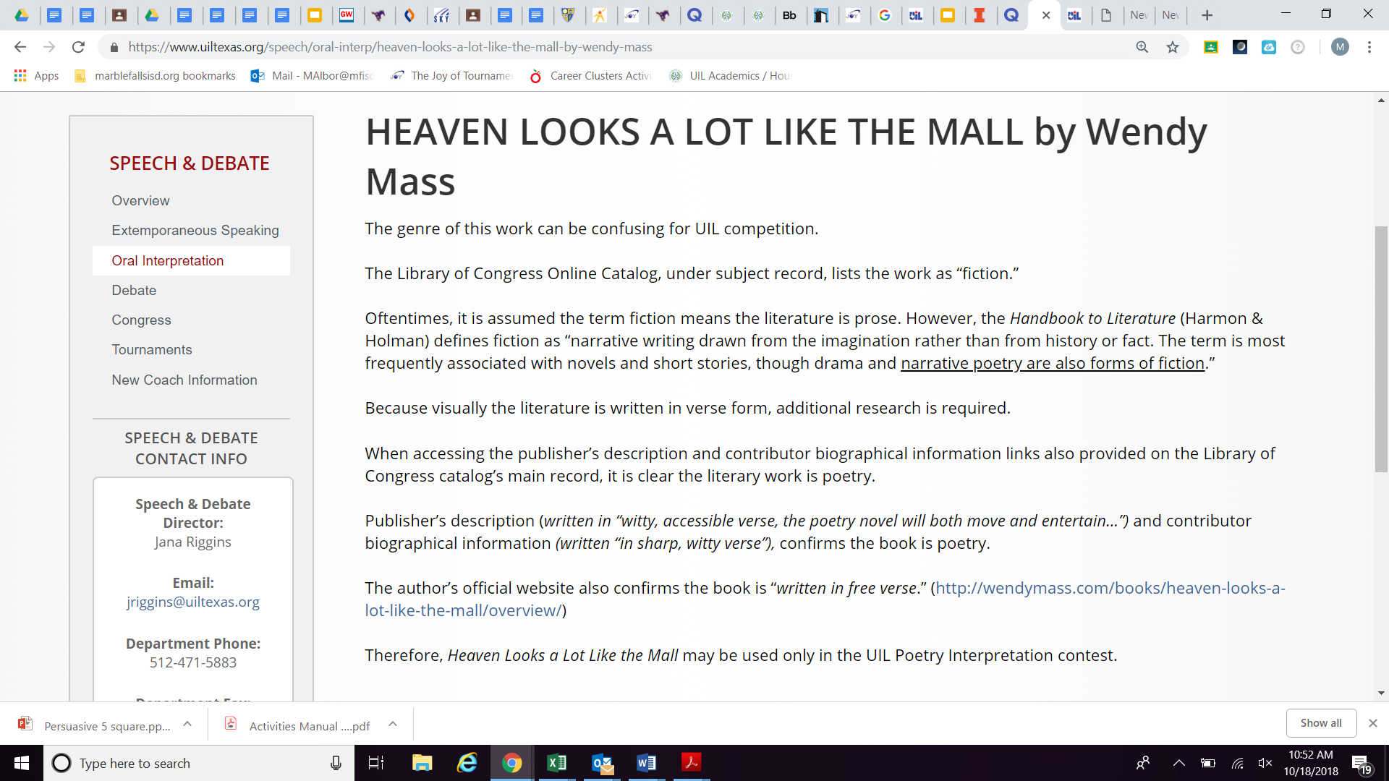

Slide 12
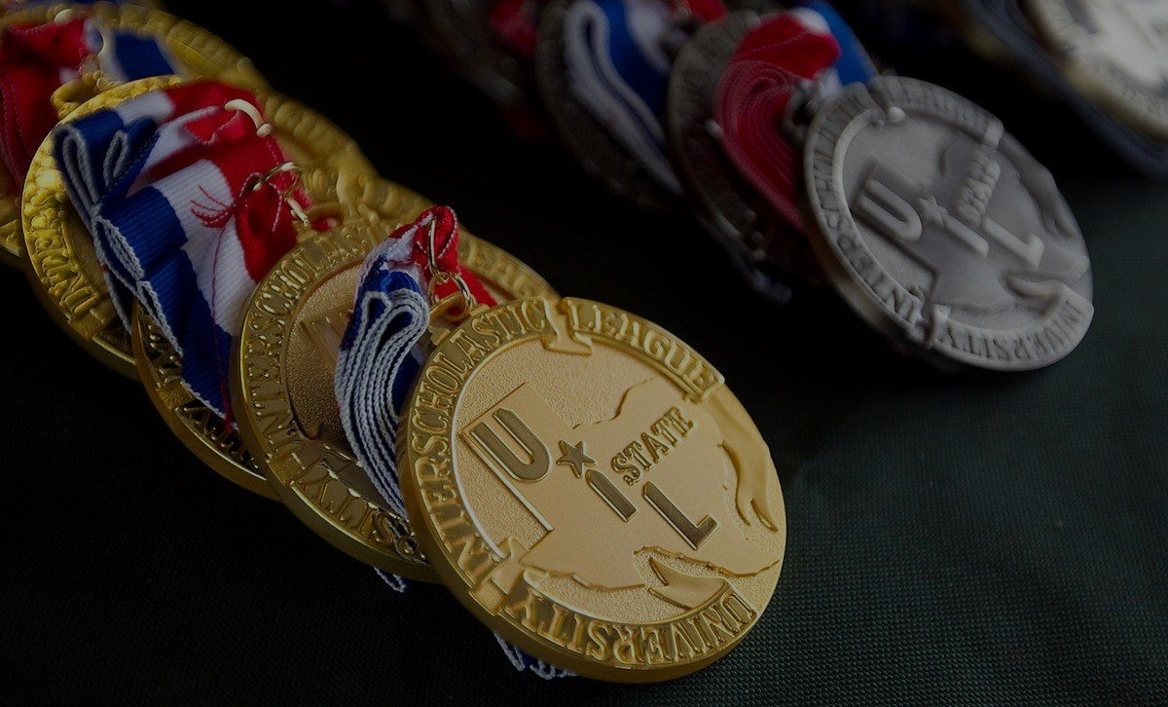
Identifying Categories & knowing the rules

Slide 13
The A & B of “C”ategories...
Categories are developed for a deeper analysis of literature. They are changed about every three years or so.
2019-2020 Poetry & Prose Categories include
Category A: This is ME
&
Category B: This Speaks to Me
NEW Categories!

Slide 14
New Categories
Category A: This Is Me
The goal of this category is to examine the performer’s ancestry, origin, heritage, and/or dreams and aspirations. The performer should explore their own personal background and/or what their future may hold.
Category B: This Speaks to Me
The goal of this category is to select literature that speaks to the performer. This category is reader’s choice.

Slide 15
POETRY Category A: This is ME!
One to six poems may be used.
If performing a single selection, the source shall be published, printed material; internet material shall be published concurrently in hard copy.
If multiple selections are used, one selection may be unpublished.
Selections from plays or screenplays, movies, and monologues shall not be used.
Song lyrics published only as music may be used, but for transition purposes only.
No contestant shall use the same poet in more than one category in the contest.
No contestant shall use selections from the same literary work more than one year at UIL State Meet.
Selections shall be read in the English translation; however, incidental use of foreign language words and phrases in any selection may be used as in the original.

Slide 16
POETRY Category B: This Speaks to Me
One to six poems may be used.
All poetic works may be published, printed material, internet material or transcribed material.
No contestant shall use the same poets in more than one category in the contest.
Anonymous works shall not be used.
Song lyrics published only as music shall not be used.
No contestant shall use selections from the same literary work more than one year at UIL State Meet.
Selections shall be read in the English translation; however, incidental use of foreign language words and phrases in any selection may be used as in the original.

Slide 17
POETRY
Category A: This Is Me
One to six poems may be used.
If performing a single selection, the source shall be published, printed material; internet material shall be published concurrently in hard copy.
If multiple selections are used, one selection may be unpublished.
Selections from plays or screenplays, movies, and monologues shall not be used.
Song lyrics published only as music may be used, but for transition purposes only.
No contestant shall use the same poet in more than one category in the contest.
No contestant shall use selections from the same literary work more than one year at UIL State Meet.
Selections shall be read in the English translation; however, incidental use of foreign language words and phrases in any selection may be used as in the original.
Category B: This Speaks to Me
One to six poems may be used.
All poetic works may be published, printed material, internet material or transcribed material.
No contestant shall use the same poets in more than one category in the contest.
Anonymous works shall not be used.
Song lyrics published only as music shall not be used.
No contestant shall use selections from the same literary work more than one year at UIL State Meet.
Selections shall be read in the English translation; however, incidental use of foreign language words and phrases in any selection may be used as in the original.

Slide 18
PROSE Category A: This is ME!
One to four selections of literature may be used.
If performing a single selection, the source shall be published, printed material; internet material shall be published concurrently in hard copy.
If multiple selections are used, one selection may be unpublished.
Selections from plays, screenplays, movies, and monologues shall not be used.
Speeches shall not be used in this category.
No contestant shall use the same writer in more than one category in the contest.
No contestant shall use selections from the same literary work more than one year at UIL State Meet.
Selections shall be read in the English translation; however, incidental use of foreign language words and phrases in any selection may be used as in the original.

Slide 19
PROSE Category B: This Speaks to Me
One to four selections of literature may be used.
All selections may be published, printed material, internet material or transcribed material.
No contestant shall use the same author in more than one category in the contest.
Anonymous works shall not be used.
Selections from plays or screenplays, movies, and monologues shall not be used.
No contestant shall use selections from the same literary work more than one year at UIL State Meet.
Selections shall be read in the English translation; however, incidental use of foreign language words and phrases in any selection may be used as in the original.

Slide 20
PROSE
Category A: This Is Me
One to four selections of literature may be used.
If performing a single selection, the source shall be published, printed material; internet material shall be published concurrently in hard copy.
If multiple selections are used, one selection may be unpublished.
Selections from plays, screenplays, movies, and monologues shall not be used.
Speeches shall not be used in this category.
No contestant shall use the same writer in more than one category in the contest.
No contestant shall use selections from the same literary work more than one year at UIL State Meet.
Selections shall be read in the English translation; however, incidental use of foreign language words and phrases in any selection may be used as in the original.
Category B: This Speaks to Me
One to four selections of literature may be used.
All selections may be published, printed material, internet material or transcribed material.
No contestant shall use the same author in more than one category in the contest.
Anonymous works shall not be used.
Selections from plays or screenplays, movies, and monologues shall not be used.
No contestant shall use selections from the same literary work more than one year at UIL State Meet.
Selections shall be read in the English translation; however, incidental use of foreign language words and phrases in any selection may be used as in the original.

Slide 21
Rules & Guidelines for Poetry and Prose
7 minute time limit (no grace period) Performer is responsible for performance (watch the time keeper & time and practice your pieces)
Must have memorized introduction and include all titles and authors
Documentation forms (and proof of publication when appropriate) required for each category
CANNOT use the same poet/author in Cat A and B
Disqualification can occur if going over time or violating categories (improper documentation during verification)

Slide 22
Rules & Guidelines for Poetry and Prose
7 minute time limit (no grace period) Performer is responsible for performance (watch the time keeper & time and practice your pieces)
Must have memorized introduction and include all titles and authors
Documentation forms (and proof of publication when appropriate) required for each category
CANNOT use the same poet/author in Cat A and B
Disqualification can occur if going over time or violating categories (improper documentation during verification)

Slide 23
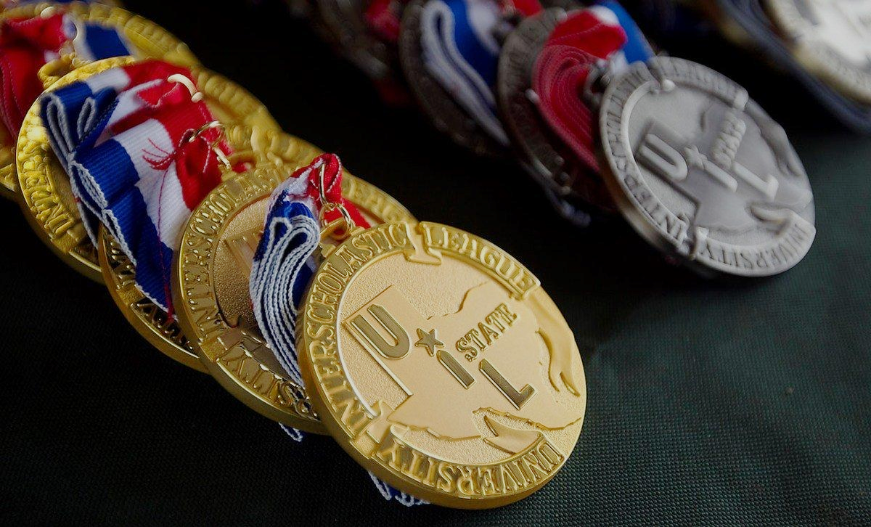
Finding pieces

Slide 24
Prose or Poetry… It is your choice
Good literature has universal appeal
Stay focused on the categories
Find your voice in your pieces
Go to tournaments-Watch and listen
READ
What is your favorite movie? It probably was based on a book!
What are your interests?
Slam Poetry and Prose readings are on Youtube
READ some more
Utilize the UIL website
Make friends with your librarian
Utilize technology - be aware of documentation rules
READ even more
Watch Youtube performances
Did I mention READING?
Consult with your Coach
Consult with your English teacher
Either one should tell a story

Slide 25
How do I pick literature?
Pick something that fits you! This is ME! It’s about you telling your story. You have to like it and be personally interested in the topic! Get busy reading! Get online to see what everybody is reading. Amazon.com, NYT Best Seller list, Goodreads, Poetry foundation, Button Poetry
Pick something that shows your talent! Don’t do dialects or accents if that isn’t your thing! Can you make the characters believable & distinct?
Select material that your audience can follow & relate to!
Does it fit the the category?
For category A – This is Me! Single selection must be published, if reading multiple pieces – One can be unpublished
For category B – This Speaks to Me! Reader’s choice.

Slide 26
Prose or Poetry…
Coaches can help guide
Encourage your students to explore literature
Ask students - What do they enjoy reading or watching? What is your story? What speaks to you? What are their interests?
Encourage students to find their own pieces! Assisting with editing and guiding your student toward pieces is part of the journey, but remember it is the performer’s journey.
Have students try pieces out at invitationals! Have “in house” invitationals with your students (or even an intradistrict) tournaments!
Coaches- Bring other teacher/coaches in to evaluate performances to help determine a team.

Slide 27
Documentation?

Slide 28
Verification and Documentation
Verifying publication is part of the process before contest day...it is never too early to start!
While proof of publication is not always required in both categories, it is always a good idea to have your original sources available (books, not kindle edition), or information from the Library of Congress Card Catalog, or copies of the cover, title page, and excerpt of piece (or pieces).
These links (on the UIL website) are helpful (literally “Helpful Checklist”)
https://www.uiltexas.org/files/academics/speech/PoetryChecklist.pdf
https://www.uiltexas.org/files/academics/speech/ProseChecklist.pdf

Slide 29
Verification and Documentation
The UIL website is a GREAT resource for you and your coach! USE it.
Documentation Forms are required for both categories and both Poetry and Prose. The specific requirements are outlined on each document (and available on the website)
https://www.uiltexas.org/files/academics/speech/Interp_Poetry_Form_19_20wWatermark.pdf
https://www.uiltexas.org/files/academics/speech/Interp_Prose_Form_19_20wWatermark.pdf
These are interactive forms that must be completed and signed by both the performer and coach, prior to contest.
Most Invitational Meets do NOT require this form, but the sooner you start on documentation, the better!

Slide 30
Verification and Documentation

Slide 31
What to expect at contests
How to dress
Performance
What to bring...

Slide 32
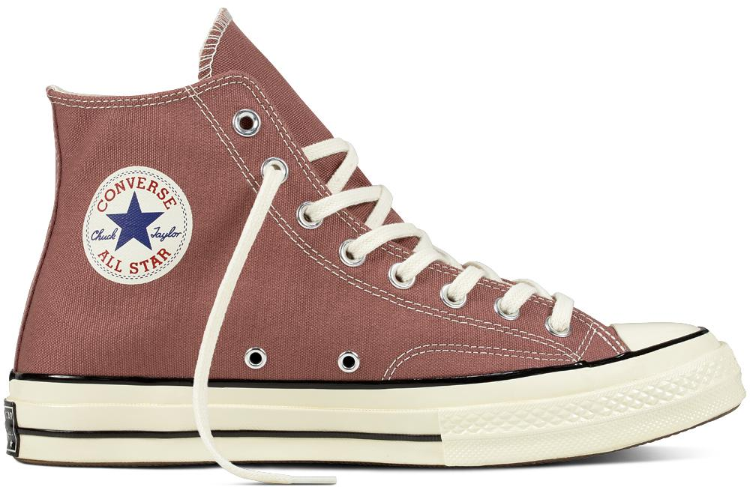
How to NOT to dress for contest...

Slide 33
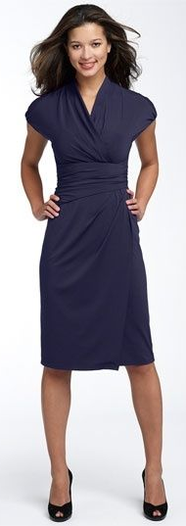
How TO dress for contest...

Slide 34
Oral Interpretation requires a manuscript
Unlike actors on stage, the interpreter is creating a believable performance through suggestion using only voice, focus, and posture to distinguish characters. Work to create a believable performance interpreting the author’s message in your performance.
You must use a physical manuscript to keep the focus on the literature. Do NOT hold the manuscript and never use it. Look down “in character” and at “appropriate times”.
Find the right use of “body and movement” in your performance. There is no imaginary box, but make sure your choices in gesture, posture, and place-to-place movement add to the literature in a believable and motivated way. Make your literature come to life with the words you are speaking.

Slide 35
Performance
How to hold your binder?
The “L” or the “V”
Don’t hold a dying swan
Introduction - “Diamond”
Preparing your binder…
5 ½” x 8 ½” black binder 3 ring binder (1” bind)
Clear sleeves
Card stock
Formatting your pages
Practice page turns
DEMONSTRATION
Jada Wise
Mart High School

Slide 36
Performance
Be Prepared!
Practice Performance and time your performance.
Vocal Warm-ups and water are a great idea before your round.
Know which piece is to be performed, remove everything else from your binder.
Memorized introduction!
Be Polite!
Do not enter a room without a judge present.
Be respectful of other performers.
Do not talk during or between performances.
Do NOT be on your phone, give it to your coach or turn it off and put it away.
Thank your judges for judging.
Be Prompt!
Be at your room before the round should start.

Slide 37
What to bring to contest
YOUR BINDER -- with your pieces
Hard copies of pieces (for documentation)
Your documentation forms - several copies completed and signed
Performance clothes - A change of clothes (it may be a long day)
Water, mints, cough drops
Shout wipes or Tide to go (just in case)
Phone charger (so you can call family when you advance!)
Don’t bring your entire bedroom…camping out in a cafeteria is part of the fun though…keep your area neat and be respectful of the space.

Slide 38
What to expect on contest day…
before preliminary round
Documentation Check-Be sure you have both online forms filled out and proof your Category A piece is published in hard copy.
You will be assigned a holding room where you will draw (or flip) for categories - sometimes the same room where documentation has occurred -Perform one for prelims and your other one when you make it to finals -- Know which piece is to be performed, remove everything else from your binder.
Draw for speaker order in contest room OR sections and order may be done by contest director before and posted-- Be prepared to give your online form to each judge. (may have single judge or panel of 3)
Get to your room early! 15 minutes before - if you are “on time” you are late!
You will be a part of the audience before and after you speak - be respectful of all performers

Slide 39
What to expect on contest day...after preliminary round
15 minute Verification Period-coaches will be allowed to view the unofficial rankings and verify tabulations. This is NOT a time to question judge decisions.
Speakers that make it to the final round will perform for places and points. (opposite category from prelims) Go watch even if you did not make it!!
Again, get to room early-stay in touch with your coach as sometimes room numbers and contest times change.
If you are watching the finals round, take notes on pieces and performances - not on your phone - be respectful of all performers
Respect the judge or judges’ decision
2 Block rule---You can discuss with your coach the judge’s decision when you are two blocks from the contest site

Slide 40
When in doubt, check it out...
Have fun! Make friends! Enjoy the competition!
http://www.uiltexas.org/speech/oral-interp
https://www.uiltexas.org/policy/constitution/academics/speech-debate

Slide 41
Questions?
Comments
Concerns

Slide 42
How to contact me...
Maribeth Harlow, Three Rivers High School, UIL Speech & Debate Coach, TTAO Contest Manager & Adjudicator
Maribeth.harlow85@gmail.com

