Slide 1
University Interscholastic League
Volleyball Update – 2013

Slide 2
AGENDA
• UIL Rule Changes
• Dates for Season
• NFHS Rules Changes
• Volleyball Plan – Practice Regulations
• Game Definitions and Regulations
• UIL Rules Compliance Program
• Forms/Student Eligibility for All UIL Contests
• Eligibility for Athletics
• Charitable Cause Guidelines
• 2013 Regional Sites
• 2013 UIL State Tournament

Slide 3
UIL RULE CHANGES 2013-14
Unless noted otherwise, effective August 1, 2013
GENERAL
•Add a 4th playoff team advancing from each district in team sport activities in Conferences 2A & 3A.
• Modify the penalty structure for a coach’s ejection.
• Reduce the number of tournaments or meets by one per season for all high school sports.
• Allow schools to substitute tournaments for games.
• Create a six-conference alignment by renaming the current conferences for the 2014-2015 school year.
• Require parents and students to sign the new Sudden Cardiac Arrest Awareness Form.
• Require parents and students in cheerleading to sign the Concussion Acknowledgement Form.
• Require cheerleading participants to follow Concussion Guidelines under Chapter 38, Subchapter D of the Texas Education Code.
• Require cheer coaches and sponsors to complete specific training related to safety guidelines for cheer.

Slide 4
UIL RULE CHANGES 2013-14
FOOTBALL
• Create a split conference alignment for 3A in 2014-15.
• Limit full contact practice for football players.
WRESTLING
• Increase the number of qualifiers from district to regionals from two to four.
SOCCER
• Limit the total number of scrimmages allowed prior to the start of regular season to three.
• Add a third conference for 2014-2015 school year.
TEAM TENNIS
• Increase the number of teams advancing from district to the new area meet to four.
• Add a third conference for the 2014-2015 school year.

Slide 5
Dates for 2013-14 Volleyball Season
August 5 First day to issue equipment and conduct workouts outside the school day, all conferences
August 9 First day for scrimmages, all conferences.
August 12 First day for matches, all conferences
November 2 District Certification Deadline
November 4-5 Bi-district – All conferences
November 7-9 Area – All conferences
November 11-12 Regional Quarterfinals – All conferences
November 15-16 Regional Tournaments – All conferences
November 21-23 State Tournament

Slide 6
NFHS RULE CHANGES 2013-14
4-1-4 Deletes reference that towel tucked in a player’s uniform waistband is an automatic violation.
5-1-1 NOTE New All contest officials shall be secured by the host school. Line judges, unless determined otherwise by state association policy, shall be provided by the host school.
*5-2-1 New The order in which the referee display the hand signals is changed to indicate the result of rally, followed by the fault. Specific mechanics shall apply for second referee-initialed calls.
5-4-4b Following the referee’s signal for end-of-set, teams are directed to the appropriate team benches and no longer report to the end lines. At the end of the match, the teams are released to follow any local or state protocol.
5-4-4d; 5-5-3(18) Clarifies the protocol and mechanics for the second referee to follow when conducting the coin toss for the deciding set.

Slide 7
NFHS RULE CHANGES 2013-14
5-3-4e The second referee shall initial the score sheet after each set and for final verification of match results.
9-2-1, 2 New; 11-3-2 New The use of electronic communication devices is permitted during the match; however, they may not be used for any review of a referee’s decision.
11-4-2 New A special time-out may be called by the referee when a team has an injured player, no time-outs remaining and no legal/exceptional substitutes available.
5-5-3a When the second referee provides assistance to the first referee on plays that may be out of view of the first referee, such as assistance is provided with a visual, informal signal and not a whistle.
5-6-3e New At the beginning of each time-out, the libero tracker shall inform the second referee of a team’s libero status.

Slide 8
NFHS RULE CHANGES 2013-14
5-7-3b Both the second referee and the official scorer will now time the 30-second injury time-out without use of the visible scoreboard.
5-9-4 In 2014, flags shall be used by line judges, unless determined by the state association to use hand signals.
11-2-3 Clarifies the state association policy for electronic media time-outs may also include the length and protocol for the time-out.
11-4-1 Either referee may stop play in the event of an injured/ill player.

Slide 9
C&CR Section 1330 VOLLEYBALL PLAN PRACTICE REGULATIONS
• One practice a day = maximum of 3 hours
• Two practices a day = no more than 5 hours; minimum of TWO HOURS rest/recovery time between the two practices
• Multiple practices may be scheduled on consecutive days (volleyball ONLY)
• No scrimmages until August 9th

Slide 10
Volleyball Coach’s Manual Game Definitions and Regulations
Single match - A single match shall be defined as: NFHS Rule 1-2-1, 2, 3
Art. 1...A match shall consist of the best three-out-of-five sets. The first team to win three sets shall be the winner of the match. The fourth and fifth sets shall not be played unless it is necessary to determine the winner of the match.
Art. 2...A match shall include a let serve.
Art. 3...A match shall entitle each team a maximum of two time-outs per set.
Dual match - consists of a team that plays two other teams or plays the same team twice at the same site (must be the same level of competition); counts as one contest for the school week, one of the two matches UIL permits students per calendar week and counts as two of the total matches for the student per season; second match should be played as soon as it can be scheduled for one team after their first match; a dual match can be held any day of the week; all teams at one site do not have to play a dual match.

Slide 11
Volleyball Coach’s Manual Game Definitions and Regulations
Double header - A student may play in a varsity and a junior varsity match , a junior varsity match and a ninth grade match, or a ninth grade and a varsity match the same night. This counts as the total two allowable matches UIL permits the student for the calendar week and counts as two of the total matches for the season.
Scrimmage - a meeting of not more than four teams for practice purposes which does not count as a game for any of the teams; admission may be charged. Officials may be paid in accordance with the schedule in Section 1204 and may, by prior agreement with the school, be reimbursed for mileage and meals. A school shall not play in a scrimmage after its first interschool game or match in that sport.

Slide 12
Volleyball Coach’s Manual Game Definitions and Regulations
Warm-up Games - Teams in the play-offs may play warm-up matches. All warm-up matches must count in the match limitation for the school year.
EXCEPTION: If the district champions have a bye for the first round, those schools may schedule a warm-up match in addition to the match limits. This additional match shall be played on a non-school night with no loss of school time. NOTE: A bi-district game may be played on Thursday during the week of a warm-up game (according to Texas Education Agency interpretations).
Pool Play - A team may play in pool play during the first rounds of a tournament provided the pool games consist of two "mini games" using rally scoring 0-15 (cap at 20) OR regulation and modified regulation 2-out-of-3 matches using rally scoring 0-25 (no cap).

Slide 13
Volleyball Coach’s Manual Game Definitions and Regulations
Tournaments - A tournament consists of at least three teams assembled at one site for competition.
• 2 matches can be substituted for one tournament
0 tournaments and 27 matches
1 tournament and 25 matches
2 tournaments and 23 matches
3 tournaments and 21 matches
• 3 matches per day in tournament play
• EXCEPTIONS: May play in 4 matches in a 1- or 2-day tournament (Friday/Saturday)

Slide 14
UIL Rules Compliance Program (RCP) 2013-14
Available ONLY via the UIL website and covers the following:
• CONSTITUTION AND CONTEST RULES (C&CR) for both HS and JH
• ETHICS AND SPORTSMANSHIP through Positive Coaching Alliance
• UIL STEROID EDUCATION VIDEO
• SAFETY TRAINING (Senate Bill 82)
• Sport-specific modules

Slide 15
UIL Rules Compliance Program (RCP) 2013-14
NFHS Required Courses - link available on the UIL website
1. “NFHS TEACHING AND MODELING BEHAVIOR” COURSE
• Minimum penalty for misconduct
• 1.5 hour course/$20
2. “NFHS FUNDAMENTALS OF COACHING” COURSE
• All first year coaches and any coach who is not a full employee of the school district (exception: coaches who qualify for the exception under Section 1202(a)(3).
• 6 hour course/$35
PLEASE PRINT CERTIFICATE TO VERIFY COMPLETION.

Slide 16
REQUIRED FORMS FOR ALL STUDENT PARTICIPATION
• Pre Participation Physical Examination Form
• Medical History Form
• Rules Acknowledgment Form
• Parent or Guardian Permit
• Parent/Student Anabolic Steroid Use and Random Steroid Testing Form
• Concussion Acknowledgement Form
• Sudden Cardiac Arrest Awareness Form

Slide 17
C&CR Section 400 STUDENT ELIGIBILITY FOR ALL UIL CONTESTS
Students are eligible to represent their school in varsity interscholastic activities if they-
• are not a high school graduate
• are a full-time student
• meet regular attendance policies/15 day rule (Varsity only)
• meet credit requirements (No pass, No play)
• are enrolled in four year program
• are eligible under the age rule (Waiver)
• was not recruited (PAPF)
• have observed all provisions of the Awards Rule
• meets requirements under C&CR Section 440

Slide 18
C&CR Section 440 ELIGIBILITY - ATHLETICS
• Meets all requirements of Section 400
• Meets Parent Residence Rule (See Section 442)
• Meets the Age Rule (See Section 446)
• Has not changed schools for athletic purposes
- Previous Athletic Participation Form (See Section 443)
• Is an amateur (See Section 441)

Slide 19
C&CR Section 443 CHANGING SCHOOLS FOR ATHLETIC PURPOSES
- All new students in grades 9-12 who have ever practiced (before, during or after school) or participated in any UIL athletic activity in grade 8-12 at another school MUST have this form completed by the previous school (last school of participation) and be approved by the District Executive Committee before they are eligible to participate at the varsity level at the new school.
- The new form includes the student eligibility questionnaire that must be completed first for any student new to that school district before participation.

Slide 20
C&CR Section 441 AMATEUR ATHLETIC STATUS
Amateur Athletic Status is violated upon the following-
1. Accepting valuable consideration as an award for winning/placing in an athletic contest. Valuable consideration is defined as anything wearable, usable or salable, and includes such items as t-shirts, hamburger coupons, free or reduced rate tennis racquets, tickets to athletic contests, etc.
2. Accept valuable consideration for teaching or coaching any UIL sport, except beginning swimming or lifesaving lessons.
3. Accept valuable consideration for allowing their name to be used for advertisement of a product, plan or service.
Notes:
Sheila

Slide 21
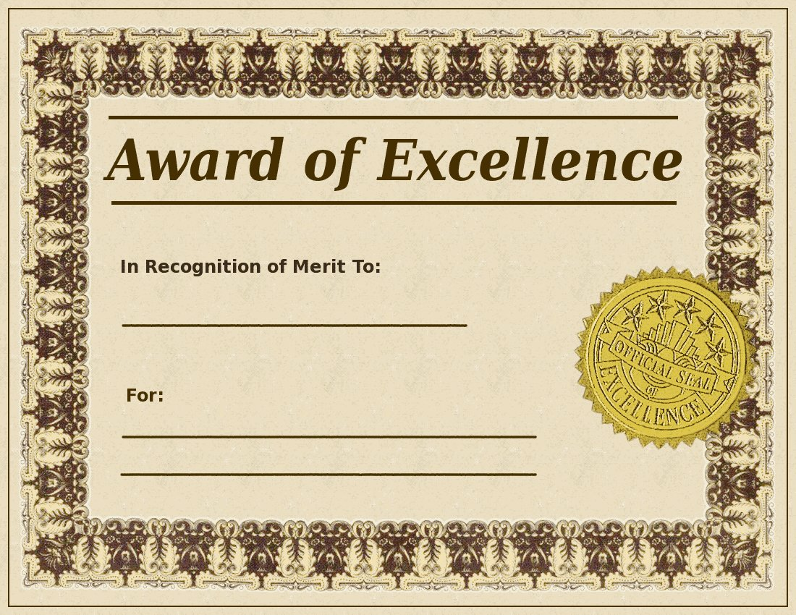
C&CR Section 480 LIMITATIONS ON AWARDS
LIMIT:
Awards Schools May Give - an award not exceed $70 in value to a student during that student’s high school enrollment at the same school for participation in UIL inter-school competition.
Awards Students May Receive - A certificate, medal, trophy or other symbolic award for participating in any UIL activity which counts on League standing, if it is given by the school, school district, the district executive committee, or the entity that organized the competition.

Slide 22
C&CR Section 441 AMATEUR ATHLETIC STATUS
Amateur Rule
Valuable consideration that school teams and athletes CAN accept-
Examples of additional items deemed allowable under this interpretation if approved by the school, include but are not limited to:
1. meals, snacks or snack foods during or after practices
2. parties provided by parents or other students strictly for an athletic team
SEE ALSO EXCEPTIONS - C&CR Section 441 (b)

Slide 23
Charitable Cause Guidelines
1. Competition may be held during any one week.
2. No exceptions to the NFHS uniform rules.
3. Jerseys of a different color than the school colors are not allowed.
4. Commemorative colored ribbon, bead, socks, etc. is recommended.

Slide 24
2013 UIL Volleyball Regional Sites 1A
Region I
The Coliseum, Western Texas College – Snyder, TX
Region II
Weatherford High School – Weatherford, TX
Region III
Lobo Coliseum, Longview ISD – Longview, TX
Region IV
Brenham High School – Brenham, TX

Slide 25
2013 UIL Volleyball Regional Sites 2A
Region I
Moody Coliseum, Abilene Christian University – Abilene, TX
Region II
Rockwall High School – Rockwall, TX
Region III
Lobo Coliseum, Longview ISD – Longview, TX
Region IV
Blossom Athletic Center, North East ISD - San Antonio, TX

Slide 26
2013 UIL Volleyball Regional Sites 3A
Region I
The Coliseum, Western Texas College – Snyder, TX
Region II
Mesquite Poteet High School – Mesquite, TX
Region III
Bryan High School – Bryan, TX
Region IV
Blossom Athletic Center, North East ISD - San Antonio, TX

Slide 27
2013 UIL Volleyball Regional Sites 4A
Region I
Moody Coliseum, Abilene Christian University – Abilene, TX
Region II
Berkner High School, Richardson ISD – Richardson, TX
Region III
Don Coleman Community Coliseum, Spring Branch ISD – Houston, TX
Region IV
TBA

Slide 28
2013 UIL Volleyball Regional Sites 5A
Region I
Glen Rose ISD Tiger Arena, Glen Rose ISD – Glen Rose, TX
Region II
Bernard G. Johnson Coliseum, Sam Houston State University – Huntsville, TX
Region III
M.O. Center, Aldine ISD – Houston, TX
Region IV
University of Texas Pan American – Edinburg, TX

Slide 29
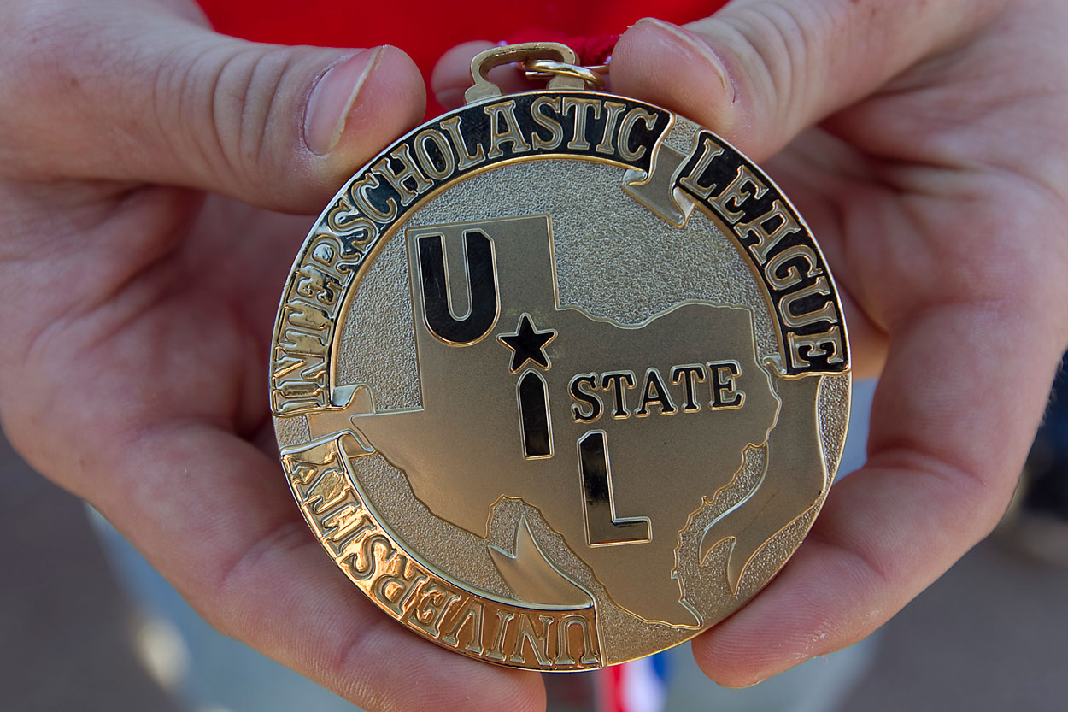
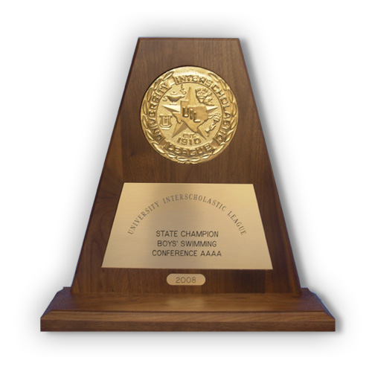
2013 UIL Volleyball State Tournament
November 21-23, 2013
Curtis Culwell Center
Garland ISD
Garland, TX

Slide 30
RESOURCES UIL Constitution and Contest Rules Volleyball Coach’s Manual NFHS Rule/Case Book TEA-UIL Side by Side Manual Booster Club Guidelines Parent Information Manual Junior High Manual

Slide 31
Questions?
Peter Contreras
pcontreras@uiltexas.org
Bree Davis
bdavis@uiltexas.org
UIL Office - (512) 471-5883
Images provided by Google

