Slide 1
UIL Theatre
2014-15

Slide 2
2014-15 Enrollment
Now Closed
1224 Entries

Slide 3
New Handbook
21st Edition Downloadable from UIL website
Combines Handbook for One-Act Play and Guide for Contest Managers
Hyperlinks included in the pdf format.

Slide 4
Approved Play Lists
Over 100 New Titles Added

Slide 5
Contest Managers
Need to take the test each year. It is an annual certification.
It is now up and running.
New procedure.

Slide 6
Advancing
1A – 6A
3 advance from zone, district, bi-district and area.
2 advance from region.

Slide 7
What If …
Only 2 in your district?
Only 3 in your district?
Only 4 in your district?

Slide 8
Bi-Districts
Districts have been paired up for the next two years.
Most of the Bi-Districts have reported info.
Check on line – Times ‘a wastin’

Slide 9
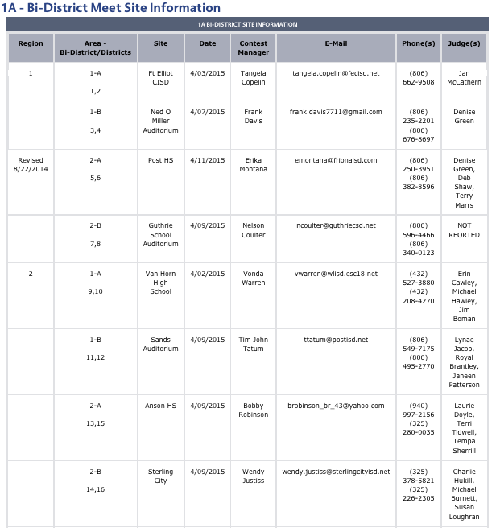

Slide 10
Missing Bi-District Info
1A - 17 & 18, 19 & 20, 29 & 30 (3)
2A –17 & 18, 31 & 32 (2)
3A - Complete
4A - Complete
5A - Complete
6A - Complete

Slide 11
Upper Level Judges
State Panels
State Meet Judges
AAAAAA - Rod Caspers+, Beverly Murray, Jim Mammarella
AAAAA - Allison Frost+, Ron Dodson, Roger Schultz
AAAA - Ricky Ramon+, Susan Loughran, Mark Pickell
AAA - R. Scott Allen+, Charles Falcon, Kelly Parker
AA - Perry Crafton+, Phillip Morgan, Lynae Jacob
A - Jackie deMontmollin+, Paula Rodriguez, Kelly Russell

Slide 12
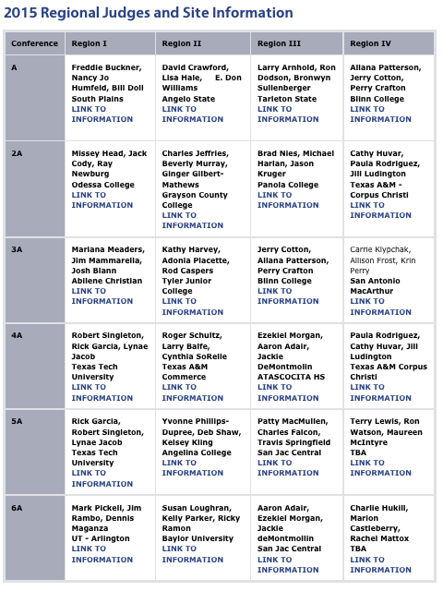
Upper Level Judges
Panels for Area Contests are posted online.

Slide 13
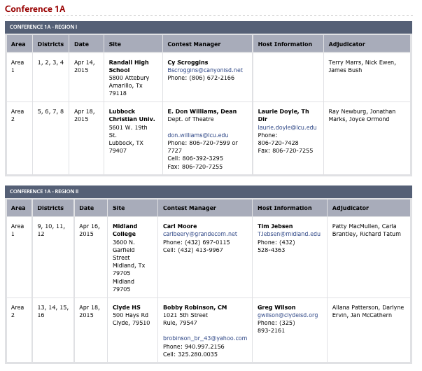

Slide 14
Region Sites 2015 & 2016
 | I | II | III | IV
1A | South Plains | Angelo State | Tarleton | Blinn
2A | Odessa College | Grayson College | Panola College | A&M – Corpus
3A | Abilene Christian | Tyler JC | Blinn | MacArthur HS
4A | Texas Tech | A&M Commerce | Atascocita HS | A&M – Corpus
5A | Texas Tech | Angelina College | San Jac | San Antonio TBA
6A | UT Arlington | Baylor | San Jac | Jefferson HS

Slide 15

New Judges Group
TTAO
Texas Theatre Adjudicators and Officials
Includes judges and contest managers
www.ttao.org

Slide 16


Slide 17
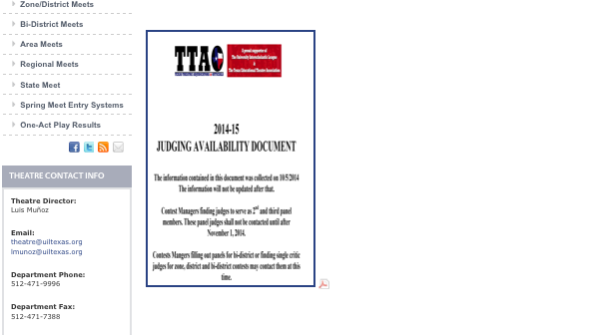
Availability Survey

Slide 18
New Rules
Mostly Handbook Changes

Slide 19
New Rules
Point Structure due to three advancing
  15, 15, 15, 10

Slide 20
New Rules
Sound Check

Slide 21
New Rules
The “Properties Allowed With Restrictions” chart has several changes and deletions.

Slide 22
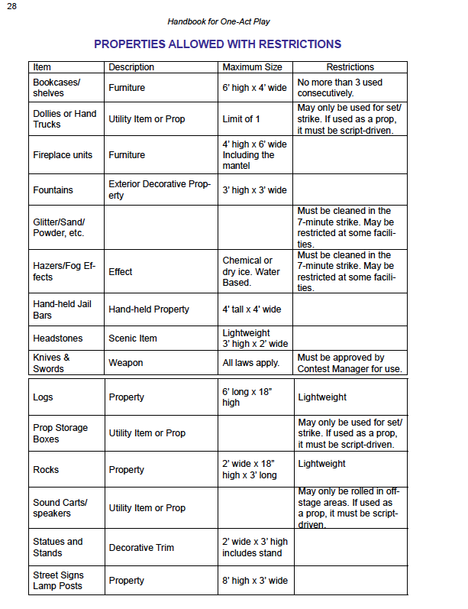
2
Carpet Restriction Gone
5’
Hand held doors/ bars
Changing to 4X6
3’X5’

Slide 23
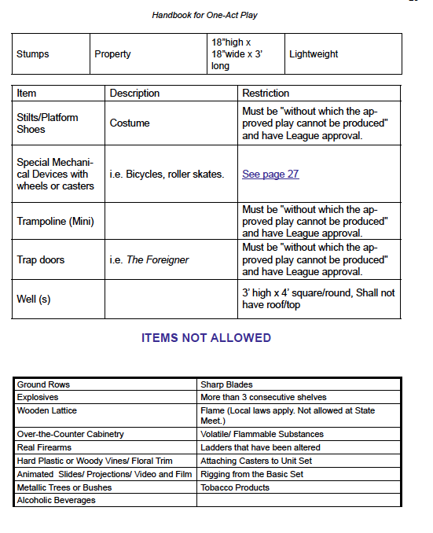
Roof Allowed
5’

Slide 24
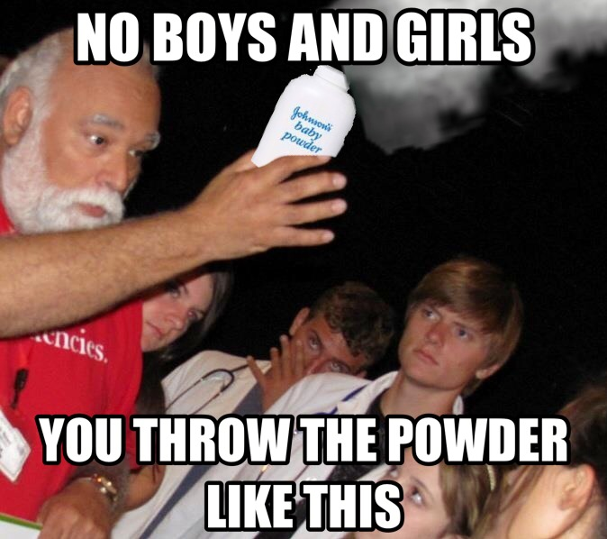
New Rules
Talcum or other powders will not be allowed without CM approval.
Photo courtesy of Keller High School and Melissa Freeman

Slide 25
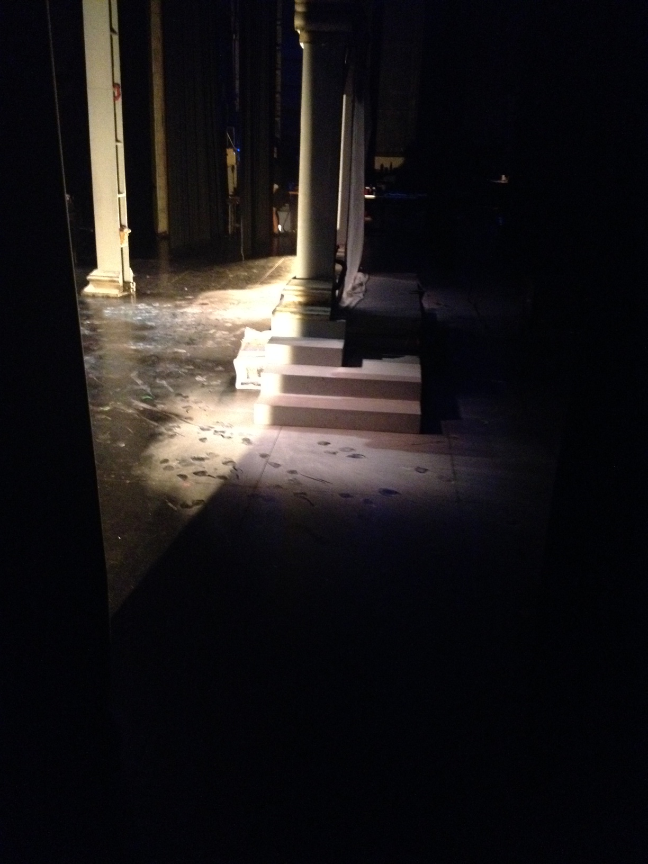
New Rules
Talcum or other powders will not be allowed without CM approval.
Photo courtesy of Keller High School and Melissa Freeman

Slide 26
Tie Breaker With Panels
In the case of an unbreakable tie
  The higher ranking school on the acting judge’s ballot shall advance or be given the higher rank.

Slide 27
State Meet Changes
Fog and hazers will be allowed.
Schools shall have the option of using a cyc.

Slide 28
Proposed Rules for 2016
The contest manager is required to declare ineligible a play that violates Section 1033 (c) (2) (C), (D) (i and ii) H, I and J. No play, which is declared ineligible by the contest manager, shall be included in final ranking or be considered for any honors, and members of the company of an ineligible play shall not be given individual awards. Violations of any other rules shall be reported to the appropriate Executive Committee.

Slide 29
Proposed Rules for 2016
A play that violates Section 1033 (c) (2) (C), (D) (i and ii) H and J shall be ineligible for advancement or final ranking. Violations of any other rules shall be reported to the appropriate Executive Committee.
The play will be eligible for acting awards and the points associated with them.
Being voted on in October.

Slide 30
Theatrical Design
CATS
Prompt is posted.
The contest will be split into two divisions: 1A – 4A and 5A – 6A.
Awards will now be given through 6th place instead of 5th.

Slide 31
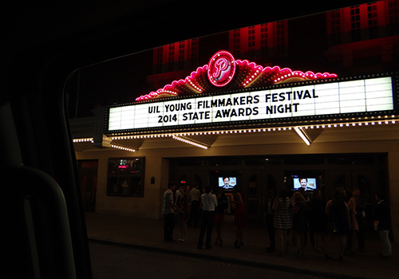
UIL Young Filmmakers Festival
Information is posted
495 entries
Great!

Slide 32
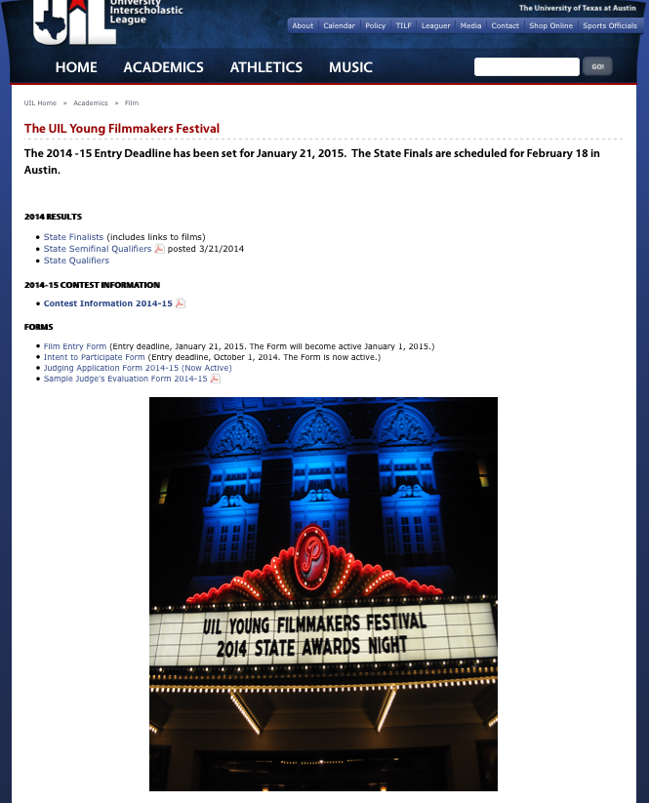

Slide 33
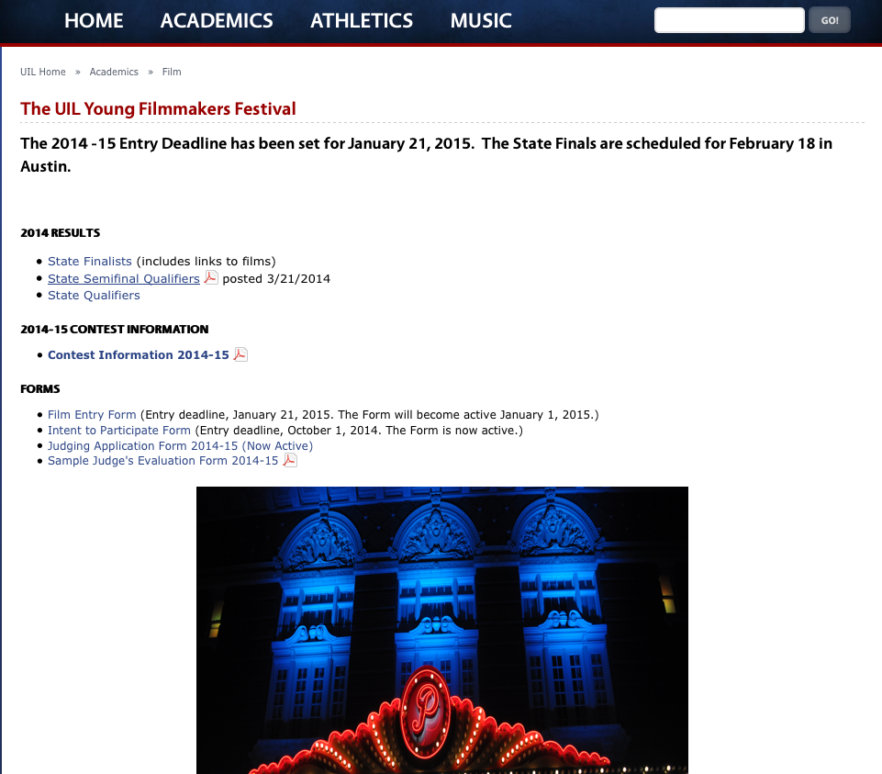

Slide 34
State Film Festival
State Champions
State Champion Animation Division 1
State Champion Division 1 Documentary
State Champion Division 1 Narrative
State Champion Division 2 Animation
State Champion Division 2 Documentary
State Champion Division 2 Narrative

Slide 35
Enjoy the Conference

